Slide 1
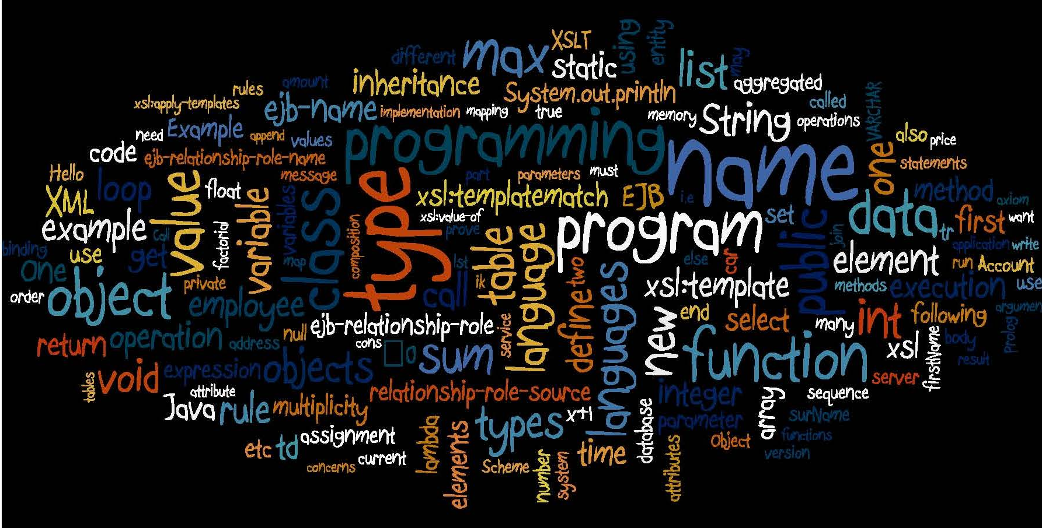
Number Systems Safe Programming
Computer Principles
for Programmers
Notes:
https://youtu.be/9bZkp7q19f0
Gangnam Style – first YouTube video to need a 64 bit counter
Set up and skip to start without ads.

Slide 2
Agenda
Base-10 programming in a binary world
Why do we care?
because (100)₁₀ == (01100100)₂ (huh?)₀₀
How can we use it?
without making mistakes
Why “Hexadecimal” numbers?
because (100)₁₀ == (64)₁₆ is easier than binary
Notes:
A computer lets you make more mistakes faster than any invention in human history—with the possible exceptions of handguns and tequila." – said Mitch Ratliff who was obviously an American.
Because 100 in denary (base-10) is whatever that is in binary
Hexadecimal, base-16, is used in HTML on the web for colours and special characters.
Why HEX? because it is easier to specify than binary.

Slide 3
Activity
Need a calculator during today's lecture
Work with integer sizes
Identify and solve an integer overflow bug.
Work with colours in both Decimal and Hex RGB values.

Slide 4
Number Systems & Safe Programming
There are 10 types of people:
01 those who know binary
10 the other nine
11 those awaiting a ternary joke

Slide 5
Number Systems & Safe Programming
There are 10 types of people:
01 those who know ternary
02 those who don't
10 those expecting another binary joke
Notes:
There are 10 types of people in the world:
01 those who know ternary,
02 those who don't,
10 and those expecting another binary joke

Slide 6
orders of magnitude of digital data
Decimal Value | Decimal Name | Sym -bol | SI prefix | Binary Value | Greek origin | d/load at 1 Gbps
1000¹ | thousand | k | kilo | 2¹⁰ = 1024¹ | chilioi “thousand” | 0.0000076 s
1000² | million | M | mega | 2²⁰ = 1024² | mégas “great” | 0.0078125 s
1000³ | billion | G | giga | 2³⁰ = 1024³ | gígas “giant” | 8 seconds
1000⁴ | trillion | T | tera | 2⁴⁰ = 1024⁴ | teras “monster” | 2.28 hours
1000⁵ | quadrillion | P | peta | 2⁵⁰ = 1024⁵ | pénte “five” | 97 days
1000⁶ | quintillion | E | exa | 2⁶⁰ = 1024⁶ | héx “six” | 272.4 years
1000⁷ | sextillion | Z | zetta | 2⁷⁰ = 1024⁷ | septem “seven” | 2,789 C
1000⁸ | septillion | Y | yotta | 2⁸⁰ = 1024⁸ | oktṓ “eight” | 285,616 M
1TB decimal = .90949TB binary 1TB binary = 1.0995TB decimal but don’t sweat it
Notes:
Remember the sequence: Know Magnitudes Grow (by) Thousands Progressing (to) Extraordinary (number of) Zeros. Yikes!
Global secondary data storage is about 10% of all data created, captured, copied, and consumed worldwide.
Storage: 6.7 zettabytes (ZB) in 2020, 7.9ZB in 2021 to around 16 zettabytes in 2025 Created: 64.2 zettabytes (ZB) in 2020, 79ZB in 2021 to around 181 zettabytes in 2025
https://www.idc.com/getdoc.jsp?containerId=US49051122 https://www.statista.com/statistics/871513/worldwide-data-created/
"one hundred thousand [data analysis] jobs are executed on Google's clusters every day, processing a total of more than twenty petabytes of data per day." THAT WAS IN LATE 2007. https://dl.acm.org/doi/10.1145/1327452.1327492
Google's total data storage was estimated at ~12.5 exabytes … in 2013 https://www.quora.com/How-much-data-does-Google-handle-a-day
Google no longer reveals its data processing numbers.
Downloading at 1 Gbps (Gigabits per second) represents the current maximum throughput from an average LTO tape drive or a small business WAN (wide area network, i.e. Internet). 10Gbps or ~1GB/sec on a dedicated connection is the best available for medium to large businesses. More than that requires a presence in TORIX or similar 'carrier hotel' such as Seneca has.
"Real world transfer speeds will vary, depending on the speed of your own Internet connection, network peering between your ISP and our upstream provider" and other factors. https://www.sync.com/help/general-limits-when-using-sync/#gspeed Even if your company has very high speed, what throughput can you expect from your cloud provider?
For anything more than a Terabyte to be d/l for data recovery, it may not matter how long it takes because it is simply too long to be practical.
"chilioi", Greek for thousands, is pronounced KHIL-ee-oy where KH is a sound between the soft sh in sheep and the hard k in key (or kilo).
70 sextillion ~= stars in observable universe prior to James Webb Space Telescope. https://skyandtelescope.org/astronomy-resources/how-many-stars-are-there/
1 zettabyte ~= 1 billion-trillion bytes, or 1 giga-terabyte
Data of all kinds "is growing, exponentially. The total amount of information created, captured, copied, and consumed globally in 2010[1] was 2 zettabytes[2] of data. This figure has grown to 97 zettabytes today [August 2022] and is expected to grow to 181 zettabytes by 2025." Unlock the information advantage to combat ‘information overload’ - OpenText Blogs, https://blogs.opentext.com/unlock-the-information-advantage-to-combat-information-overload/
Decimal and binary values in orders of thousands are frequently confused, with the decimal version becoming more commonly used (to avoid explaining binary). Don't bother correcting anyone, it's close enough for normal conversation.
SI is "International System of Units" includes the metric system but not Imperial or USC (United States Customary) units.
“Kilo”, from the similar sounding Greek word, was used by the metric system to describe thousands of units such as kilograms, kilometers. (kilo-meters, not ki-LOM-eters; no one says mi-LIM-iters for milli-litres) A thousand kilos became a mega-great, a thousand greats became a giga-giant, a thousand giants became a tera-monster. The story of thousands upon thousands was building excitement telling of great giant monsters but when a thousand monsters became five, six, seven, eight, the plot became quite predictable and the screenplay was never optioned by a major movie studio.

Slide 7
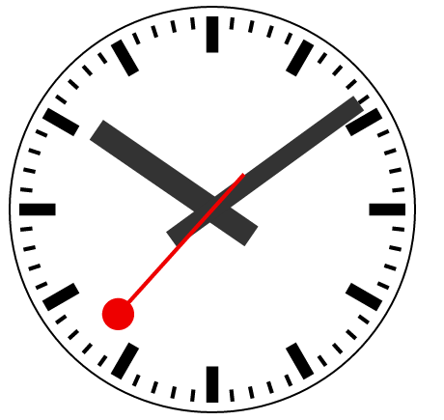
Humans
Analog Decimal
Computers
Digital Binary
 | 2⁷ | 2⁶ | 2⁵ | 2⁴ | 2³ | 2² | 2¹ | 2⁰
 | 128 | 64 | 32 | 16 | 8 | 4 | 2 | 1
H |  |  |  |  |  |  |  | 
M |  |  |  |  |  |  |  | 
S |  |  |  |  |  |  |  | 
Notes:
The time is shortly after 10 o’clock. that is useful information for humans and can be determined by a quick glance at an analog clock.
For more on Analog vs Digital: https://chortle.ccsu.edu/java5/Notes/chap02/ch02_1.html
Real Life is analog and we count in tens. Digital Life is on or off, in bits and bytes and ones and zeros.
Like the Denary base ten, Binary is just numbers. It can be challenging to think in binary even though there are only two numbers to think about.
People: how are you? Fine or Lousy. That is usually a binary answer heard as analog. Your friend knows if you are really 80% fine and 20% lousy. Or, your friend understands irony: when you say “lousy” at a great party and “just fine” in the middle of exam week are both understood with the logical NOT.
Computers: The CPU says to the memory cache, “How are you?” Memory cache says, “I think I have a parity error.” CPU says, “Yeah, you look a bit off.”
People: how is your computer? No one knows for sure. From the computer’s POV, what does it know about how it is? Only that it is ON or OFF. There is no MAYBE. That’s OK, who wants a computer that can’t make up its mind.

Slide 8
Numbering Systems
How many ways can you represent 2023?

Slide 9

2023 toothpicks
Notes:
the year can be represented by
1,1,1,1,1,1,1,1,1,1,1,1,1,1,1,…this is going to go on for quite a while.
2023 toothpicks
#include <stdio.h> // C language module providing Input/Output facilities
int i; // safely using i as if it was short type, <=32,767
int main(void) {
for (i = 1; i <= 2023; i++) {
printf("|"); // output a toothpick
if ( i % 100 == 0) { // every hundred outputs,
printf("\n"); // line break
}
} // end for
return 0;
} // end main

Slide 10
Numbering Systems
How much is 2023?
One, two, three, many.
MMXXIII
0000011111100111
8:23 PM
Numbers, by themselves, are just…numbers. Context matters.
The cardinal number 2,023 is different from the year 2023.
Few or many depends on context: years, $$$, stars in galaxy 2023 = two millennia $2,023 = 1 PC 0.000002% of stars * * before James Webb Tel. found at lot more
Notes:
The same numeric value can mean different things.
One, two, three, many. That’s it. Four values are all some societies in the Amazon, Australia, and Africa have needed. Would that modern life was so simple.
Romans used units of ones, fives, tens, fifties, hundreds, five-hundreds, thousands: Symbol I V X L C D M
Value 1 5 10 50 100 500 1,000
Can you read the year a movie was made before the final credits roll off the screen? MCMLXXXVIII is 1988. MCMXLIV is 1944.
How easy is it to count in binary? Easy as 1 10 11. (one, two, twone)
Context matters
2,023 as a cardinal number (number of students on campus) is very different from 2023 as a Gregorian year.
20:22 is 8:22 PM where the base for hours it is 24.
Our brains have concepts of orders of magnitude depending on context
Thousands is a lot in terms of years, not as much as it used to be in terms of money, not very many in terms of stars in our galaxy.
Arabic numerals used a unique symbol for each of 0-9 and columnar position to indicate orders of magnitude X 10: ones, tens, hundreds, Thousands, etc.
See https://instacalc.com/1439
https://en.wikipedia.org/wiki/History_of_ancient_numeral_systems

Slide 11
8 bit byte (8×2)² = 2⁸ = 256
2⁷ | 2⁶ | 2⁵ | 2⁴ | 2³ | 2² | 2¹ | 2⁰
128 | 64 | 32 | 16 | 8 | 4 | 2 | 1
0 | 1 | 0 | 1 | 0 | 1 | 0 | 1
Is 01010101 char 'U' or decimal 85 ?
if ('U' == 85) is True.
Only binary matters to computers.
Notes:
8 bits × 2 possible values {0,1} squared = 2^8 = 256 combinations of ones and zeros.
Values range from 0 – 255, (zero is a value) from all 8 bits off (0) = 0 to all 8 bits on (1) = 255
All bits on = 128+64+32+16+8+4+2+1 = 255 is highest numeric value for unsigned 8-bit integer. (signed on next slide)
Slide example: 64+16=80+4=84+1=85
It is a variable’s type which determines what the binary values in memory represent to software.
Deeper dive
In C language, a char data type is usually unsigned [0–255] and means an alphanumeric character.
Char is the smallest addressable unit of memory; it contains a value in the ASCII character set. (American Standard Code for Information Interchange)
It is an integer type and the only numeric type where the default is unsigned. All other numeric types default to signed which is how they should be used. Never override the default signed | unsigned.
If using C99 or newer, use stdint.h to specify numeric types, especially for a byte not used as a plain text character. e.g. for a numeric 'small integer’ int8_t is the type for a signed, 8 bit value (-128 to +127). Do not use signed char
uint8_t is the type for an unsigned, 8 bit value (0 to 255). Do not use char
See https://stackoverflow.com/questions/1409305/best-practices-should-i-create-a-typedef-for-byte-in-c-or-c

Slide 12
Signed and unsigned within a single byte. Integers −/+ signed by default * unsigned by request
255 0
----------------------unsigned----------------------
Notes:
There is no binary negative, only zero and one – this is the root of the problem.
This is how most computers represent both positive and negative numbers at the binary level. This way, the hardware does need to know whether the binary represents a positive or negative value. When bits are added together, they result in the correct answer. [details are in the notes below and on another slide way below] −128 10000000
+127 +01111111
−1 11111111
--------------------------------------------------------------------------------------
Positive and Negative numbers share half the bits of an integer where zero is considered on the positive side. The most significant (leftmost) bit is off for positive and on for negative numbers.
The min/max for signed integers is ½ the maximum values for unsigned of the same type.
As illustrated on this slide, Two's Complement is the most common method of dealing with signed values but it cannot be expected; there are other methods of internal representation -- determined by hardware design, not software. Add the bits (of negative integer) to the bits (of a positive integer) and the result will be correct in either binary or decimal arithmetic. This makes arithmetic faster because the hardware never has to know if the value is negative or positive, it just adds bit registers together at the binary level. (There is no binary negative, only zero and one – this is the root of the problem.) Add any two negative and positive matching numbers and the result will always be zero. Meaning any value added or subtracted from zero will be correct.
The "complementary" aspect is that each positive binary number has a corresponding complement with equivalent but negative value. To compute the complement, invert all the bits and add 1.
+3 00000011
11111100 inversion
+1 conversion −3 11111101 complement
00000010 inversion
+1 conversion
+3 00000011 complement
1 is added due to the unequal distribution of non-zero positive and negative values within the integer.
Why share the bits this way, with half positive and half negative? Because, with two's-complement, the fundamental arithmetic operations of addition, subtraction, and multiplication are identical to those for both signed and unsigned binary numbers. This property makes the system both simpler to implement—there is no special handling of positive vs negative numbers—and is capable of easily handling higher precision arithmetic: just use more bits. (https://en.wikipedia.org/wiki/Two's_complement)
The disadvantage is overflow when 127 + 1 becomes −128. But we have that problem with unsigned binary numbers (255 + 1 = 0), with one's complement, and also with decimal numbers in programming or DB columns where there are always limits on maximum / minimum values.
Overflow goes to the bit bucket https://en.wikipedia.org/wiki/Bit_bucket
So you say your computer running slowly…hmmm, did you empty the bit bucket? No? Nobody told you? Well, that's the problem. Every time you end a program, the OS has to get rid of the used memory, so it throws the RAM your program used into the bit bucket. For efficiency, it leaves the zeros and only throws the 1 bits away. Your bit bucket has overflowed and is clogging things up. It's like taking out the garbage. Everyone throws stuff away but nobody likes cleaning up afterwards. "How do you empty the bit bucket?" Well, go to the back of the computer…okay, have you got a screwdriver? …
Reference https://www3.ntu.edu.sg/home/ehchua/programming/java/datarepresentation.html
This example shows a type __int8, a signed version of the char type which is rarely employed but useful for the example. Integers of larger size (more bits) have the same overflow behaviour.
"two's complement" is because it's in base 2. The general mathematical term is "radix complement" and radix for binary is 2.
https://en.m.wikipedia.org/wiki/Two's_complement
The two's complement is calculated by inverting the digits and adding one.
e.g.
Decimal +1 = binary 0000 0001 has this two's complement 1111 1111 which is -1 decimal
Decimal -1 = binary 1111 1111 has this two's complement 0000 0001 which is +1 decimal
Applies to values from -127 to 127. The negative is the complement of the positive and vice versa.
Two's complement of -128 is -128, of 0 is 0.
6 subtract 4 is handled as 6 + two's complement of 4 which is -4 6 + -4 = 2

Slide 13
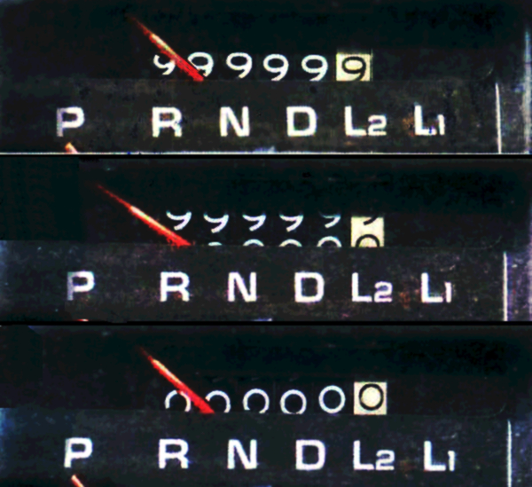
Binary Processing Cautions
What happens when you have too many?
add 1 to max = overflow
Notes:
https://en.wikipedia.org/wiki/Integer_overflow
What happens when you have too many? It doesn't matter. You must always have a data type sized to hold more than enough.
In the days of mechanical odometers, cars were not expected to go more than 100,000 miles before being scrapped.
If a car's mechanical odometer "rolled over", you could tell from the condition of the car that it did not have zero miles on it.
There was a tell-tale dye which appeared on the numbers if the odometer was rolled backwards by a dishonest dealership.
Computers, on the other hand, do not tell you about overflow. You are just supposed to know – this is the price of fast.

Slide 14
Binary Processing Cautions
What happens when you have too many for the data type?
It doesn't matter. Data type must hold more than enough.
But what happens when overflow has occurred?
Overflow in C is undefined, therefore unpredictable, and unstoppable -- program continues with binary values.
* overflow *
unsigned | bits | signed
127 | 01111111 | 127
+1 | 00000001 | +1
128 | 10000000 | −128*
unsigned | bits | signed
255 | 11111111 | −1
+1 | 00000001 | +1
0* | 00000000 | 0
Notes:
What happens when you have too many? It doesn't matter. You must always have a data type sized to hold more than enough.
Software has no control over the binary. C cannot identify the underlying binary representation which would be necessary to predict overflow. Because C cannot know, the program carries on because C doesn't know.
-------------------------------------------------------------------------------------------
In the C programming language specification, signed integer overflow causes undefined behavior because there are three different architectures to store signed values, all with different side-effects. On most platforms—because most use Twos Complement—signed overflow behaves like unsigned integer overflow: integers rollover, the 1 that should be carried to the next order of magnitude goes into the “bit bucket” because there is nowhere to store the next order of magnitude. But this cannot be assumed.
32,767 + 1 = −32,768 − 1 = 32,767 or 65536 + 1 = 0 − 1 = 65536.
The machine is accumulating bits. Only your program knows if the bit value means unsigned or signed. Program must be proactive to avoid overflow – cannot catch it after the fact. Neither the OS nor C will throw an error.
https://www.embeddedrelated.com/showarticle/532.php Understanding and Preventing Overflow
https://en.wikipedia.org/wiki/Integer_overflow

Slide 15
Binary is Binary, Context Matters
printf("'%c' ASCII %d", x, x);
unsigned/signed 'q' ASCII 113
'r' ASCII 114
's' ASCII 115
't' ASCII 116
'u' ASCII 117
'v' ASCII 118
'w' ASCII 119
'x' ASCII 120
'y' ASCII 121
'z' ASCII 122
unsigned '{' ASCII 123
'|' ASCII 124
'}' ASCII 125
'~' ASCII 126
'⌂' ASCII 127
'Ç' ASCII 128
'ü' ASCII 129
'é' ASCII 130
'â' ASCII 131
'ä' ASCII 132
signed
'{' ASCII 123
'|' ASCII 124
'}' ASCII 125
'~' ASCII 126
'⌂' ASCII 127
'Ç' ASCII -128
'ü' ASCII -127
'é' ASCII -126
'â' ASCII -125
'ä' ASCII -124
Notes:
binary value of x, when interpreted as a char or a decimal data type looks like the 8-bit binary for a character or the binary for a base 10 number. It is the program that translates the exact same binary into whatever it wants.
short x; // signed 16-bit works as an 8-bit %c char because only the right-hand, lowest order 8 bits are used for %c. The 9th to 16th bit positions are IGNORED.
for(x=0; x<=255; x++) // x<= (255 +256) or +512) or +738) or +1024) also work as does starting x at −32768 instead of 0 ==> start x at any multiple of 256
{
printf("'%c' ASCII %d", x, x); // %c interprets binary in x as an alphanumeric ASCII character
// %d interprets binary in x as a base 10 numeric value
}

Slide 16
Binary Processing Prudence
signed vs unsigned compares the binary values results may be unexpected
C# and Java do not have unsigned integers which are unsafe when compared with signed integers or when mixed in calculations.
➔ use only signed integer data types and if (thisInt == thatInt) { /* will always be correct */ }
unsigned | bits | signed | unsigned vs signed
255 | 11111111 | -1 | 255 == -1 is true ✗
 |  |  | 255 > -1 is false ✗
 |  |  | 255 < -1 is false ✓
Notes:
Pitfalls in C and C++: Unsigned types http://soundsoftware.ac.uk/c-pitfall-unsigned.html
Unsigned integers can hold twice as many positive values as signed but twice as much is not worth the side-effect danger when unsigned and signed integers are combined in Integral (arithmetic) or Relational (comparison) expressions.
-1 signed is 1111 1111 binary, 255 unsigned is 1111 1111 binary – they compare as equal.
signedVariable { + - * / } unsignedVariable = potentially unpredictable arithmetic result
CPU and APU cannot tell the difference in data types. Bits are just bits to the computer; it doesn't know what they mean. Only the programmer does.
https://www.geeksforgeeks.org/what-is-an-expression-and-what-are-the-types-of-expressions/
https://softwareengineering.stackexchange.com/questions/175253/why-does-an-unsigned-int-compared-with-a-signed-character-turn-out-with-an-unexp
https://stackoverflow.com/questions/5416414/signed-unsigned-comparisons
https://blog.regehr.org/archives/268 and http://sjoerdmeijer.blogspot.com/2013/05/why-not-mix-signed-and-unsigned-values.html
https://www.google.com/search?q=Why+Not+Mix+Signed+and+Unsigned+Values+in+C%2FC%2B%2B%3F&ie=utf-8&oe=utf-8
C# and Java don’t provide unsigned integer types for good reason: it’s too prone to subtle errors introduced by binary processing when signed and unsigned are mixed in calculations.
https://www.learncpp.com/cpp-tutorial/unsigned-integers-and-why-to-avoid-them/
https://stackoverflow.com/questions/199333/how-do-i-detect-unsigned-integer-multiply-overflow in C, unsigned arithmetic does not overflow
printf("\ncompare unsigned versus signed integers\n");
int i = -1;
unsigned int unI = INT_MAX; // init unsigned with signed int maximum, all good
printf("\t%u == %d is %s\t%s\n", i, unI, (i == unI ? "true" : "false"), "CORRECT");
printf("\t%u > %d is %s\t%s\n", i, unI, (i > unI ? "true" : "false"), "CORRECT");
printf("\t%u < %d is %s\t%s\n", i, unI, (i < unI ? "true" : "false"), "CORRECT");
unI = UINT_MAX; // init unsigned with unsigned int maximum, mostly bad
printf("\t%u == %d is %s\t%s\n", i, unI, (i == unI ? "true" : "false"), "WRONG");
printf("\t%u > %d is %s\t%s\n", i, unI, (i > unI ? "true" : "false"), "WRONG");
printf("\t%u < %d is %s\t%s\n", i, unI, (i < unI ? "true" : "false"), "CORRECT");
printf("\n");
compare unsigned versus signed integers
4294967295 == 2147483647 is false CORRECT
4294967295 > 2147483647 is true CORRECT
4294967295 < 2147483647 is false CORRECT
4294967295 == -1 is true WRONG
4294967295 > -1 is false WRONG
4294967295 < -1 is false CORRECT

Slide 17
Bits and bit width Know how many. Get a tattoo.
n bits encode 2^{n} values = bit width
8-bit char = 2⁸ = 256 values (unsigned) 0 – 255
16-bit short = 2¹⁶ = 65,536 values from 32,767 to −32,768
32-bit long = 2³² = 4,294,967,296 values (65,536²) 2,147,483,647 to −2,147,483,648
64-bit long long = 2⁶⁴ = 1,2,3,many but slow to process
int short long data types are signed by default, must declare unsigned int but don’t.
Notes:
Binary is easy for computers and hard for humans.
Humans understand ones, tens, hundreds, thousands, i.e. orders of magnitude.
Computers understand binary according to the 8-bit byte which is the computer's order of magnitude.
As programmers we need to conceptualize binary orders of magnitude.
What integer length is needed to hold 2020? Is 8 bits enough? 16? 32? Is 64 too much of a memory hog?
How many bits do you need to store 2020 in binary? 11, therefore we need at least a short int. Who would know this off the top of their head?
What is the maximum value for a signed 32-bit integer? 2,147,483,647 The value is too hard to remember in base 10,
it’s easy in base 2, it’s 31 ones: 01111111111111111111111111111111 (not 32 ones – that is likely minus 1)
The easiest way to remember exact binary values is to get a tattoo. Or, just remember +/- 2 billion which will usually be the case for PCs and servers…but not for IoT or embedded devices. Therefore, always remember and expect 32,767 as the max value of an integer to write safe and portable code.
65,536 values = 256² / 2 – 1 = 32,767
4,294,967,296 values = 256⁴ / 2 – 1 = 2,147,483,647
Integers come only in multiples of the 8-bit byte “word” or register size, the smallest unit of data in computer architecture. https://en.wikipedia.org/wiki/Integer_(computer_science)
A long long or big integer (IBM’s BIGINT) is a 64-bit binary integer with a range of -9,223,372,036,854,775,808 to +9223372036854775807. That’s a 9 with 18 zeros or 9 quintillion.
CPUs address similar amounts of RAM depending on their addressing bit width:
32 bit processors or operating systems can address a maximum of 4GB RAM
32 bit application software can address only 2GB of memory for variables and it’s own data (the rest of RAM is for the OS and the program itself) regardless of whether it runs on a 32-bit or 64-bit OS.
64 bit applications support up to 128GB of memory but must be compiled, tested, and run on a 64-bit platform.
Bill Gates never said, "640K ought to be enough for anybody" defending the IBM PC's 640KB usable RAM limit at the introduction in 1981. Gates did say, "I've said some stupid things and some wrong things, but not that. No one involved in computers would ever say that a certain amount of memory is enough for all time." and "The machine was going to be 512K at one point, and we kept pushing it up".
https://msdn.microsoft.com/en-us/library/0b726ydb.aspx
http://en.cppreference.com/w/c/types/integer
https://en.wikipedia.org/wiki/C_data_types

Slide 18
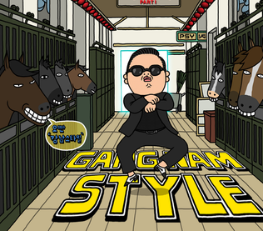
Binary Processing Problems
Gangnam Style breaks YouTube, Dec. 2014
PSY - GANGNAM STYLE(강남스타일)
YouTube view counter goes to 64-bit width
> 4.6B views since 15 July 2012
Notes:
Gangnam Style overflows 32-bit INT_MAX ~2.5 years after its debut, forces YouTube to go 64-bit
https://arstechnica.com/information-technology/2014/12/gangnam-style-overflows-int_max-forces-youtube-to-go-64-bit/
https://www.wired.com/2014/12/gangnam-style-youtube-math/
http://en.wikipedia.org/wiki/Integer_overflow
Gangnam Style was the first YouTube video counter to exceed a 32-bit integer (signed, of course because Jawed Karim was a good programmer)
https://www.youtube.com/watch?v=9bZkp7q19f0 https://en.wikipedia.org/wiki/History_of_YouTube
If Karim had cheated and used unsigned long (4.2 × 10⁹) instead of long long (9.2 × 10¹⁸), the Gangnam Style counter would have overflowed before the end of 2021.
However, Baby Shark Dance has had twice as many views in half the time, so even a unsigned long would not have been long enough for very long. (12B+ views as of January 2023. World population is 8B. So everyone on the planet has seen it 1 ½ times.)
unsigned long max is 4,294,967,296 Gangnam Style views average ~1.275M per day since 2012, and are still running about a million per day with 4,217,958,605 views as of October 16, 2021.

Slide 19
Binary Processing Problems
If a counter tracks hundredths of a second, how many days would it take for an integer to overflow?
SHORT_MAX (32,767) = almost right away…we can guess that.
LONG_MAX (2,147,483,647) = +R “calc”.
The End is coming for UNIX: January 19, 2038 03:14:07
UNIX epoch 1970-01-01 00:00:00 + LONG_MAX seconds = The End
32-bit Unix systems will go back in time 136.1 years due to overflow.
On 2033-05-17, timestamps will reach 2,000,000,000 seconds. Save the date for geek, nerd, and Unix user group parties!
Notes:
16-bit int would overflow in less than 5 ½ minutes.
INT_MAX / 100 / 60 / 60 / 24 = 248.55 days before the counting of hundredths of a second overflows in a 32-bit SIGNED integer. INT_MAX divided by hundredths = seconds that can be counted in this variable, / 60 = minutes, /60 hours, /24 = days. /365 = years, /10 = decades, …
Alternatively:
24 hrs * 60 min per hr * 60 sec per min * 100 per sec = 8,640,000 hundredths of seconds in a day MAX_INT value divided by X units counted per day = Y days before overflow.
https://www.flightglobal.com/news/articles/faa-orders-new-787-electrical-fix-to-prevent-power-f-411794/
https://www.federalregister.gov/documents/2015/05/01/2015-10066/airworthiness-directives-the-boeing-company-airplanes
On 30 April 2015, the Federal Aviation Authority ordered Boeing 787 Dreamliner operators to reset the electrical system to avoid a signed integer overflow which could lead to complete loss of normal electrical power and a switch to emergency systems. “If the four main Generator Control Units (for one A/C generator on each engine plus backup generators) were powered up at the same time, after 248 days of continuous power, all four GCUs will go into failsafe mode at the same time, resulting in a loss of all AC electrical power regardless of flight phase.”
Note that each Generator had a mechanical backup but there was no backup for the software control system – there was only one that controlled everything.
This didn't happen because planes were shutdown for service before 248 days had passed.
Boeing issued a software update in the fourth quarter of 2015. The error could happen after 248.55 days of continuous operation indicating a 32-bit signed integer. (2,147,483,647 / 100 hundredths / 60 seconds / 60 minutes / 24 hours) If they had counted full seconds, it would not have happened for 24855 days or 68 years of continuous operation. That’s still a bit tight; Douglas DC-3’s have been flying for 70+ years. If the programmer specified a “long long” int; it would have taken 3 billion years to overflow the counting of hundredths of a second.
According to Boeing's records, all jets in the fleet have been powered off and turned back on as part of routine maintenance, so there is no imminent danger of a plane losing power. (i.e. the counter runs in memory and is initialized on a cold boot) But, as the WSJ notes, the Dreamliner has run into other technical glitches, which were often worst right after powering up. Boeing has suggested allowing extra time for the plane to boot up, but in practice, airlines sometimes just keep the planes on to avoid the extra headache.
What if the analyst mis-wrote or the programmer mis-read the specs and implemented cumulative instead of continuous operation; the value would have been stored in non-volatile memory to remember operation time. Planes would have been doing emergency landings or possibly crashing on take off or landing after 8 months in service.
A much bigger issue is that only the hardware had backup, each mechanical-electrical generator had a backup BUT THE SAME SOFTWARE SYSTEM CONTROLLED THEM ALL. The software had no backup, nothing to check whether the decisions made by the controlling software were reasonable and confirmed by an independent external measurement.
"If you are trying to design highly reliable systems and redundancy is an important part of your safety case, then you’d damn well better give a lot of thought to common mode failures of the software system. In this case, Boeing clearly had not, resulting in a supposedly fail-proof system that actually has a trivially simple catastrophic failure mode." – https://embeddedgurus.com/stack-overflow/2015/05/boeing-dreamliner-bug/
Boeing 737 Max crashes in 2018 & 2019
the underlying problem isn’t really software; it’s with the effort to use software to get around a whole host of other problems, i.e. mechanical design kludges to fit bigger engines don’t blame software that’s the band aid for many other engineering and economic forces in effect. https://www.vox.com/business-and-finance/2019/3/29/18281270/737-max-faa-scandal-explained
Very big (long int) and very little things (hundredths of a second) are hard to gauge.
https://en.wikipedia.org/wiki/Integer_overflow
The end of 32-bit time: January 19, 2038 03:14:07 for the UNIX epoch beginning 1970-01-01T00:00:00Z
Unix systems record time values as the number of seconds, positive or negative, since 00:00:00 UTC on January 1, 1970. 32-bit systems use a signed 32-bit integer for this which gives a range of 1970 +/- 68.05 years.
But 2,147,483,647 +1 seconds after that date, the integer value will overflow and likely wrap around to a negative value. On January 19, 2038, at 03:14:07 in the morning, 32-bit Unix systems will go back in time 136.1 years.
Not a problem for any contemporary UNIX system, they are all 64-bit. But 32-bit embedded systems are still a problem.
Per https://en.wikipedia.org/wiki/Year_2038_problem …
"There is no universal solution for the Year 2038 problem. Any change to the definition of the time_t data type would result in code compatibility problems in any application in which date and time representations are dependent on the nature of the signed 32-bit time_t integer. For example, changing time_t to an unsigned 32-bit integer, which would extend the range to the year 2106, would adversely affect programs that store, retrieve, or manipulate dates prior to 1970, as such dates are represented by negative numbers. Increasing the size of the time_t type to 64-bit in an existing system would cause incompatible changes to the layout of structures and the binary interface of functions."
4 digit year overflow, the Y10K problem. See https://en.wikipedia.org/wiki/Year_10,000_problem and https://tools.ietf.org/html/rfc2550#ref-YUCK

Slide 20
Binary Processing Prudence
What will never overflow on a 32-bit platform can easily overflow on a 16-bit platform
INT_MAX = 32,767 or 2,147,483,647 platform INT_MIN = -32,768 or -2,147,483,648 dependent
INT_MIN <= x+y <= INT_MAX // primary effect
INT_MIN – 1 = INT_MAX // side-effect INT_MAX + 1 = INT_MIN // side-effect
Never program for a side-effect. Never ever be clever.
Notes:
INT_MAX and INT_MIN ⬅ all languages can tell you what the maximum/minimum value of an INT is. Same for other data types: type_MAX type_MIN
PROBLEM: int type may be short or long depending on the C language implementation: platform and compiler.
A 32-bit integer is 65,538 times larger than a 16-bit integer, thus the need for caution.
C99 language spec says int is a signed integer type. Capable of containing at least the [−32,767, +32,767] range; thus, it is at least 16 bits in size. However, many small embedded systems are 8-bit and not C99 compliant so their int may have only 256 values.
C language int type is sized on a platform according to two factors: a) natural bit width or 'word' size on the target processor. This is usually 32 or 64. The term 'word' is used for a small group of bits that are handled simultaneously by processors of a particular architecture. The size of a word is thus CPU-specific. Many different word sizes have been used, including 6-, 8-, 12-, 16-, 18-, 24-, 32-, 36-, 39-, 40-, 48-, 60-, and 64-bit. An int normally corresponds to the natural word size of a platform and can, properly aligned, be accessed quickly. The machine reads a word at a time; using data types other than the word size requires masking and shifting which reduces efficiency.
b) integer width scheme (data model) defining how different programs communicate; a uniform data model is used within a given operating system application interface. This will be the lowest common width in the hardware & software system and is why an integer is usually 32 bits wide on systems with 64-bit CPUs.
Do not program with logic that depends upon the overflow side-effect. A side-effect is when an operation has an effect on a variable/object that is outside the intended usage. Always program within the intended usage. Never be clever. In all cases, the results of calculations exceeding min/max for the numeric data type are considered unpredictable (C language specifications say the result is "undefined"). Even if you think you can calculate allowing for two's complement overflow, or use the overflow behavior in your logic, DO NOT DO THAT. It is programming to a side-effect and is very, very dangerous. in Mathematics, computing the correct value of a + b is considered to be the primary effect of a function/operation whereas any other effects are considered side-effects. Overflow is a side-effect. Your C program does not know if the platform's ALU uses one's or two's complement. Regardless of platform or version of the language, the primary effect will always be the same, the side-effect may not.
https://en.wikipedia.org/wiki/C_data_types#Basic_types
https://en.wikipedia.org/wiki/Integer_overflow
https://stackoverflow.com/questions/3944505/detecting-signed-overflow-in-c-C
int add(int lhs, int rhs)
{
if (lhs >= 0) {
if (INT_MAX - lhs < rhs) { // check if there is room to add
/* would overflow */
abort();
}
}
else {
if (rhs < INT_MIN - lhs) { // check if there is room to subtract
/* would overflow */
abort();
}
}
return lhs + rhs; // sum will not overflow
}
For deeper reading on sizing variables, especially for embedded systems, see
https://embeddedgurus.com/stack-overflow/2008/06/efficient-c-tips-1-choosing-the-correct-integer-size/
https://www.informit.com/articles/article.aspx?p=1620206

Slide 21
Binary Processing Prudence
C language implementation varies by compiler & platform
C code could compile successfully but run differently.
Data types have minimum sizes: platform's int width varies 8–64
For portability, declare exact size/type you need <stdint.h>
intnn_t = minimum 100 times bigger than the biggest value expected.
For efficiency, declare int
platform will use 16-bit or more but know the sizeof(int)
Then test, test, test, test, test the edge cases
gcc –std=c99 -pedantic -Wall -Wextra -Wshadow -Wconversion -Wstrict-overflow=5 -Wsign-conversion -Wformat­=2 –Werror
examine compiler warning messages
Notes:
Implementation = compiler + platform (hardware and OS).
Your C code could compile successfully but run differently under another implementation. Even different compilers on the same platform could result in differently running code.
By the time C was standardized, there were many C compilers on many platforms.
For backward compatibility, variations in data type sizes had to be accepted as valid.
For portability with C99 compilers, declare the size you need: short or long or long long for 16-bit or 32-bit or 64-bit but never “int”.
See https://barrgroup.com/Embedded-Systems/How-To/C-Fixed-Width-Integers-C99
ISO C99 standard includes new <stdint.h> header file to declare fixed width integer data types, to make hardware interfacing in C easier: e.g. int8_t, int16_t, int32_t, int64_t
These typedefs specify exact-width integer types for more portable code, have minimum and maximum value macros for each type, particularly useful for embedded programming.
https://en.wikibooks.org/wiki/C_Programming/stdint.h
https://en.cppreference.com/w/c/types/integer
https://www.informit.com/articles/article.aspx?p=1620206
What happens when you have too many? It doesn't matter. You must always have a data type sized to hold more than enough.
The easiest way to remember maximum values for data types is to get a tattoo. However, short : 32767 and long : 2 billion will be all you need to know in most situations.
For efficiency, declare int the compiler will optimize processing for the target platform.
C compilers are supposed to be written for performance which means different strategies and maybe different results on different platforms.
A guy closes his umbrella and walks into an office building. Just two steps in, he slips and falls on the floor. “Hey buddy, you OK? Didn’t you see the wet floor warning sign?”
“Yeah, I did, but I’m a programmer. We pay no attention to warnings; we only look at errors.”
For safe programming, ask for the warnings:
gcc -pedantic -Wall -Wextra -Wshadow -Wstrict-overflow=5 -Wwrite-strings -Werror
-Wall -Wextra Turn on all warnings to help ensure the underlying code is secure.
-Wconversion -Wsign-conversion Warn on unsign/sign conversion.
-Wformat­-security Warn about uses of format functions that represent possible security problems.
-Werror Turns all warnings into errors.
https://gcc.gnu.org/onlinedocs/gcc-4.0.1/gcc/Warning-Options.html
https://gcc.gnu.org/onlinedocs/gcc/Warning-Options.html#Warning-Options
https://stackoverflow.com/questions/154630/recommended-gcc-warning-options-for-c
https://gcc.gnu.org/onlinedocs/gcc/Integer-Overflow-Builtins.html
http://www.pixelbeat.org/programming/gcc/integer_overflow.html
http://www.softwaretestingclass.com/what-is-exhaustive-testing-in-software-testing/
Exhaustive testing is usually impossible but searching for "Exhaustive testing" will lead to what is possible.

Slide 22
Floats and Doubles — fractions
In binary, what is the value between 0 and 1?
A float or a double, when your program is run,
Can cause you great trouble before it is done.
Values can muddle, though it all seems like fun,
They float like a bubble, between zero and one.
Notes:
Of course, there is no value between zero and one in base 2.
A programmer walks into a cafe and asks for 1.014 root beers. The bartender says, “I’ll have to charge you extra, that’s a root beer float”. The programmer says, “In that case, better make it a double.”
You can have very large values or very small values but not both at the same time. A float has at least 6 positions of accuracy regardless of where the decimal point is. e.g. 0.123456 or 123456.0 or 123.456 A double has 10 positions of accuracy, AKA "scale". The compiler and platform may give more positions of precision and accuracy, but not less.
Run demo program in .zip file: sizeof_Data_Types.c
sizeof(float) = 4 bytes, 24 significant bits
significant digits accuracy = min. 6 positions of whole + fractional parts. i.e. the number of base-10 digits that can be represented accurately.
sizeof(double) = 8 bytes, 53 significant bits
maximum value = 2^53 = 9007199254740992
significant digits accuracy = 15 regardless of decimal point's position (using Visual Studio IDE on Windows/64)

Slide 23
Floats and Doubles — underflow
min. scale 1 / 1 = float 1.000000000000000000000000000 6 decimals 1 / 1 = double 1.00000000000000000000000000000000 10 decimals
1 / 2 = float 0.500000000000000000000000000 1 / 2 = double 0.50000000000000000000000000000000
1 / 3 = float 0.333333343267440795898437500 1 / 3 = double 0.33333333333333331482961625624739
1 / 4 = float 0.250000000000000000000000000 1 / 4 = double 0.25000000000000000000000000000000
See a pattern?
Notes:
Float is a single-precision floating-point type with 6 reliable decimal digits known as "scale". Precision is the total number of significant and decimal digits.
Double is known as double-precision fp. 15 reliable decimal digits of scale in Visual Studio on Windows/64
See https://en.wikipedia.org/wiki/C_data_types
See a pattern here? See next slide, too.
1 / 3 = float 0.3333333432674407958984375
1 / 3 = double 0.3333333333333333148296162562473909929394721984863281250
Condition known as underflow The term arithmetic underflow (or "floating point underflow", or just "underflow") is a condition in a computer program where the result of a calculation is a number of smaller absolute value than the computer can actually represent in memory on its CPU. See https://en.wikipedia.org/wiki/Arithmetic_underflow
When floating point values exceed the maximum accuracy of their data type, they do not overflow. Adding 1 may not increase the value, adding 3 could increase the value by 2: TEST! (N.B. maximum accuracy, not maximum capacity – there is no maximum capacity, just diminishing accuracy for very large or very small numbers)
Floating-Point Numbers Aren’t Real
http://www.freshsources.com/FPNotReal.pdf

Slide 24
Floats and Doubles — underflow
min. scale 1 / 5 = float 0.200000002980232238769531250 6 decimals 1 / 5 = double 0.20000000000000001110223024625156 10 decimals
1 / 8 = float 0.125000000000000000000000000 1 / 8 = double 0.12500000000000000000000000000000
1 /10 = float 0.100000001490116119384765625 1 /10 = double 0.10000000000000000555111512312578
1 /16 = float 0.062500000000000000000000000 1 /16 = double 0.06250000000000000000000000000000
See a pattern?
Notes:
If the fraction is a power of 2, the decimals are accurate because they are an exact binary value of 2 to the n^{th} power. Otherwise, fractional values beyond a certain precision are a binary estimate.
1 / 5 = float 0.20000000298023223876953125
1 / 5 = double 0.2000000000000000111022302462515654042363166809082031250
1 /10 = float 0.100000001490116119384765625
1 /10 = double 0.1000000000000000055511151231257827021181583404541015625
printf("%f", myFloat);
printf("%.2f", myFloat); // auto rounds to 2 decimal positions
// .2 represents the number of decimal places to show after the decimal separator WITH ROUNDING
printf("%.6f", myFloat); // TEST to show less rounded value
// *
floatValue += .005 ; // force variable data to round to nearest penny when considering two decimal places only
0.44444 (44 cents rounded on output) +0.005 becomes 0.44944 (44 cents without rounding)
0.44999 (45 cents rounded on output) +0.005 becomes 0.45499 (45 cents without rounding)

Slide 25
Floats and Doubles — fractions
In a binary system, what value is between 0 and 1?
Every fractional value is an approximation between 0 and 1.
Not to be used for monetary or exact values in business
DECIMAL data types are integers with implied decimal positions DECIMAL size 9.2 (precision.scale) contains 1,234,567.89
BE VERY CAREFUL mixing integer and floating-point types
Do not compare floats and doubles, only powers of 2 are ==
In general, use doubles. Precision sacrifices scale as significant digits increase in value. The decimal point floats!
Test edge cases of expected highest/lowest values.
Notes:
There are small quirks in the binary approximation of decimal fractions depending on the value, size of the data type, rounding behavior, and hardware/software implementation.
It is not necessarily a smooth distribution of decimal fractional values in the binary world.
There are differences in rounding at the limits of precision (float rounds up, double rounds down).
In IBM systems, there has always been a DECIMAL data type, base 10, just like humans use, for business and financial applications. Other databases now support a DECIMAL data type as do high-level languages like Java, C#, Python, Objective-C.
E.g. DECIMAL size 9.2 contains 1,234,567.89 It overflows at ten million: 9,999,999.99. Even with decimal data types, we have to ask, “Is this wide enough?” The tech term for bigness is usually "width" as in how many bits wide?
When sizing variables, it is recommended to allow for at least two decimal orders of magnitude more than the highest expected value. E.g. if the client is sure DECIMAL size 9.2 containing up to 9,999,999.99 is sufficient, make the variable size DECIMAL size 11.2
See Floating Point Numbers – Computerphile (9 minutes)
https://www.youtube.com/watch?v=PZRI1IfStY0&ab_channel=Computerphile
There are small quirks in the binary approximation of decimal fractions depending on the value, size of the data type, rounding behavior, and hardware/software implementation.
It is not necessarily a smooth distribution of decimal fractional values in the binary world.
There are differences in rounding at the limits of precision (float rounds up, double rounds down).
never compare floats or doubles using == because it checks if binary values are the same: okay for integers but not floating point
The best you can do is to take their difference and check if it is less than an epsilon (machine epsilon is the maximum relative error ) https://en.wikipedia.org/wiki/Machine_epsilon
#include <float.h>
if ( abs(fx - fy) < FLT_EPSILON ) // if absolute value of diff between two floats is LT epsilon, then consider equal
if ( abs(dx - dy) < DBL_EPSILON ) // if absolute value of diff between two doubles is LT epsilon, then consider equal
Actual properties of float and double are unspecified (except that double is not smaller than float),
** therefore, portability between systems is not necessarily predictable **
on most systems, size and behaviour are according to IEEE 754 standards for floating-point format
where float is 32 bit and double is 64 bit. Floats and double exhibit identical behavior within the limits of a float.
When programming with floating point, know what you need: what range of values are processed and how exact must the results be. Performance usually varies inversely with data type size, long in bit length = short in performance.
Double can represent values from -2⁵³ to 2⁵³
but very large whole numbers will sacrifice decimal precision. Very, very large whole numbers exhibit the same behaviour as decimal values where the only accuracy is with values that are powers of 2. e.g. +1 to a float at its maximum value will result in a value that is +2.

Slide 26
Floats and Doubles — fractions
How many programmers does it take to change a lightbulb?
1.0000000000000011102230246251565404236316680908203
Never use a float or double when a short or long will do.
Notes:
How many programmers does it take to change a lightbulb?
• Approximately one.
After rounding, how many programmers does it take to change a lightbulb?
• None, it’s a hardware problem.
How many hardware engineers does it take to change a lightbulb?
• None, they’ll fix it in software.
How many low-level software engineers does it take to change a lightbulb?
• "It's hard to say. Each time we separate the bulb into its modules to do unit testing, it stops working."
How many maintenance programmers does it take to change a lightbulb?
• None. They try to fix the old one.
How many Linux users does it take to change a lightbulb?
• None - there is no problem with the lightbulb, you’re using your house wrong.
Of course, as everyone knows, back in the day, all it took was a couple of university kids in a garage in Palo Alto to change a lightbulb.
double test = 1 + 0.000000000000001; // adding 1 from the 15th decimal position
printf("%.32f\n", test ); // gives value shown in above slide
double test = 1 + 0.0000000000000001; // adding 1 in 16th decimal place does not compute, it is ignored
printf("%.32f\n", test );
http://syque.com/cstyle/ch9.2.htm
http://syque.com/cstyle/ch10.3.htm

Slide 27
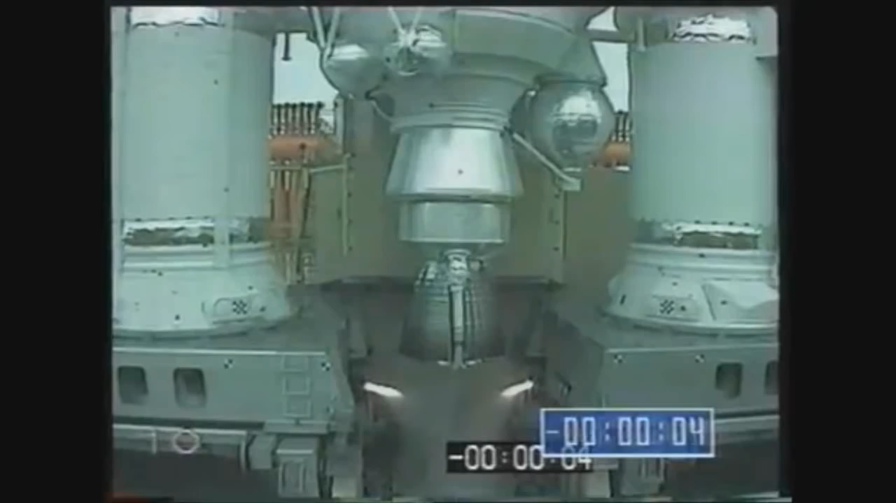
Ariane 5 rocket
10 years and $7B of development
1st flight June,1996
Ariane 4 software
Ariane 5 was faster
36 seconds of normal flight
at 36.7 seconds… data conversion of 64-bit double to 16-bit integer
at 37 seconds… course correction
at 39 seconds… $500M loss
Notes:
Photo from https://commons.wikimedia.org/wiki/File:Ariane_5ES_with_ATV_4_on_its_way_to_ELA-3.jpg
The Explosion of the Ariane 5 https://www-users.math.umn.edu/~arnold/disasters/ariane.html
Longer (00:1:46) video of 'Ariane 5' Rocket first launch failure/explosion with sound.
https://www.youtube.com/watch?v=gp_D8r-2hwk
You did test the software, didn’t you?
– No need. It worked fine on the Ariane 4
But the Ariane 5 is more powerful.
– So?
It can carry heavier payloads.
– No problem.
It is also faster than the Ariane 4 (after 36 seconds of flight). A higher velocity means more events per unit time.
– Faster? Hmm, I wonder if that will be a problem.
Yup, that was a problem.
– But hey, it worked fine for the first 36 seconds. Let’s not overstate the issue. Only the last 3 seconds were problematic.

Slide 28
Programming goes wrong on overflow
Ariane 5 rocket self-destructs 40 sec after launch in 1996
casting a 64-bit double to 16-bit int needs 275B int variables
For 6 hours, over 6000 people got a busy signal calling 911
911 call routing stopped after a counter reached maximum
Therac-25 radiation therapy device kills 6 (1985-1987)
error++; If (error != 0) means do not irradiate patient +1 to a byte 256 times equals zero. use isError set to true|false
Toyota Sudden Unintended Acceleration kills ~400 (2002-2010)
data type casting altered values. 30% of switch without error traps
Notes:
Ariane 5 rocket self-destructs 40 seconds after launch
June 4, 1996 – Ariane 5 Flight 501. Working code for the Ariane 4 rocket is reused in the Ariane 5, but the more powerful Ariane 5 engines provided extra payload capacity and, incidentally, capable of higher velocity: more events per unit time occured. This triggered a bug. First Flight 501's backup computer crashes, followed 0.05 seconds later by a crash of the primary computer which used the same software. [Only the hardware had a backup, not the software!] The rocket disintegrates 40 seconds after launch.
"The error is in the code that converts a 64-bit floating-point number to a 16-bit signed integer. "
The real error is in thinking such a conversion is a good idea. But, because the software worked on the Ariane 4, it was carried over to the Ariane 5 – known as cargo cult programming or blindly copying code from a similar implementation.
Who thought a double precision floating point value which can be up to 9,007,199,254,740,992 (over 9 quadrillion or 2^53 integer precision) would fit into an integer with a maximum of 32,767. You would need almost 275 billion 16-bit signed integers to hold the maximum accurate value in a 64-bit double.
https://around.com/ariane.html
https://en.wikipedia.org/wiki/Double-precision_floating-point_format#C_and_C.2B.2B
https://en.wikipedia.org/wiki/Cargo_cult_programming
911 busy signal
For six hours on April 9, 2014, 911 emergency services went dark for more than 11 million Americans across seven states due to an entirely preventable software error. You'd think that counting up to 40 million 911 calls would never happen. But it did. And because the programmers hadn’t anticipated the problem, they hadn’t created alarms to call attention to it. Nobody knew what was happening. For six hours, no one knew 911 calls were going nowhere. https://apps.fcc.gov/edocs_public/attachmatch/DOC-330012A1.pdf April 2014 Multistate 911 Outage: Cause and Impact. Report and Recommendations. Public Safety Docket No. 14-72. PSHSB Case File Nos. 14-CCR-0001-0007
"When it originally designed the software for its PTM, Intrado programmed it with a pre-set maximum of sequential log record numbers. At around midnight on April 9, the PTM module in Intrado’s Englewood IPSR reached this maximum, at which point it ceased generating additional CAMA trunk assignments for incoming 911 calls. When subsequent requests for CAMA trunk assignment were received, the PTM did not respond, interfacing timers timed out, and 911 calls were no longer completed to those PSAPs with CAMA trunks. In other words, these calls destined for PSAPs using CAMA trunks went nowhere. This amounted to over 87 percent of all 911 calls during the outage. Notably, the IPSR did not issue any major or critical alarm for this outage. Instead, it issued several thousand minor alarms for calls not completing, but these did not attract the attention of Intrado staff. " page 13 [ this seems rather odd since the entire point of the system was to route calls! ]
1985-1987 – Therac-25 medical accelerator.
A radiation therapy device malfunctions and delivers lethal radiation doses at several medical facilities. Six patients die; others are seriously injured due to over exposure. Therac-25 "improved" the Therac-20's electromechanical safety interlocks with software control, a decision made because software was perceived to be more reliable. But software for the Therac-25 – a machine without hardware interlocks was based Therac-6 and -20 models that have mechanical safety mechanisms.
What Thereac engineers didn't know was that both the 20 and the 25 were built upon an operating system and real-time controller that had been kludged together by a programmer with no formal training. The control software appeared to have been written by a programmer with little experience coding for real-time systems. There were few comments, and no proof that any timing analysis had been performed. According to AECL, a single programmer had written the software based upon the Therac-6 and 20 code. An expert programmer would have insisted on having another expert on the project. Expert programmers would have each written different major parts of the code that had to work together (executive real-time machine functions and application level software), written test cases for the other programmer’s code, reviewed each other's code, and performed testing together. When there is only one point of view and one person's understanding of the problem being solved, it had better be PERFECT.
Side-effect logic: In traditional C programming (before version C99), false is represented by 0, and true is represented by any numeric value not equal to 0 which is, technically not-false. The distinction seems academic as far as program evaluation goes but that is not the point, readability and meaning to a human programmer is the goal. Until C language version C99, the Boolean data type did not exist (bool). The Therac software set a True condition by incrementing a variable (failTest = failTest + 1), rather than by setting it to a constant non-zero value (failTest = 1). Occasionally an arithmetic overflow occurred, causing the flag to return to zero and the software to bypass safety checks. Programmers often use C variables to mean two things (a bad practice in general): Is there a problem? and How many problems do we have? It only works reliably if there are no problems. E.g. If there are exactly 256 problems, a byte counter (unsigned or signed) will loop back to zero indicating no (or 256) problems!
IF statements without a relational operator and comparison are usually used when the tested variable is a boolean (or used exactly like one). Decision logic should be expressed in terms of a human value indicating the meaning of the decision logic, not whether C would correctly interpret the value as false or not-false.
UX flaw: When the system noticed that something was wrong, it halted the X-ray beam and displayed "MALFUNCTION" with a number from 1 to 64. The user manual did not explain or even address the error codes. To an operator, the message was meaningless. In a machine like this, the operator cannot just see that something is wrong. It's not like it had a flat tire. Operators could press the P key to override the warning and proceed anyway. After all, why would a machine allow you to override an error message if something was really wrong?
Program design/flow error: The equipment control task did not properly synchronize with the operator interface task, so that race conditions occurred if the operator changed the setup too quickly. (the tasks were multi-threaded when they should have been single-threaded.) This was missed during testing, since it took some practice before operators were able to work quickly enough to get ahead of the equipment control task. The setup UI should have been "modal", i.e. blocking the application flow until information required to continue is entered.
Race condition joke example: Knock, knock. Race condition. Who’s there.
https://en.wikipedia.org/wiki/Therac-25 https://en.wikipedia.org/wiki/Thread_(computing) https://en.wikipedia.org/wiki/Race_condition https://en.wikipedia.org/wiki/Modal_window
http://www.ccnr.org/fatal_dose.html
http://www.cs.umd.edu/class/spring2003/cmsc838p/Misc/therac.pdf
http://sunnyday.mit.edu/papers/therac.pdf
https://hackaday.com/2015/10/26/killed-by-a-machine-the-therac-25/
http://courses.cs.vt.edu/professionalism/Therac_25/Therac_1.html …/Therac_2.html …/Therac_3.html
http://courses.cs.vt.edu/professionalism/Therac_25/Therac_4.html Lessons learned and System engineering
http://courses.cs.vt.edu/professionalism/Therac_25/Therac_5.html Software engineering
http://courses.cs.vt.edu/professionalism/Therac_25/Side_bar_1.html …/Side_bar_2.html …/Side_bar_3.html …/Side_bar_4.html …/Side_bar_5.html
“Human intuition is poor at estimating the true probability of supposedly ‘extremely rare’ combinations of events in systems operating at a scale of millions of requests per second,” CHRIS Newcombe wrote in a paper. “That human fallibility means that some of the more subtle, dangerous bugs turn out to be errors in design; the code faithfully implements the intended design, but the design fails to correctly handle a particular ‘rare’ scenario.”
// not just error++
if (aConditionIsWrong)
{
error++; // number of errors
isError = true; // do we have an error?
}
if (isError AND !error ) { // then BIG PROBLEM
whoa(); // stop!
}
Sudden Acceleration in Toyota Vehicles 2002 – 2010+
$3B+ in fines and lawsuit settlements.
https://en.wikipedia.org/wiki/Sudden_unintended_acceleration#Sudden_Acceleration_in_Toyota_Vehicles
https://embeddedgurus.com/barr-code/2013/10/an-update-on-toyota-and-unintended-acceleration/
Nearly 400 wrongful-death and personal injury cases were settled by Toyota as a result of unintended acceleration: $3B+ in fines and lawsuit settlements.
250,000 lines of code in the Electronic Throttle Control System (ETCS) module described as "spaghetti code"
80,000 lines not to industry standards, almost 1/3 of the code.
11,000 global variables where there should be only as few as absolutely necessary
105 of 343 switch statements had no default or error trap and other poor programming practices. Error trap is an unconditional catch-all at the end of an IF/ELSE or switch structure. E.g. IF (true1) {do this} ELSE IF (true2) {do that} ELSE IF (true3) {do other} ELSE {unknow condition; never expected to get here; go into failsafe and/or debug mode} ENDIF
Of 67 functions in the ETCS code, 75% were measured as so complex as to be untestable.
Excessive recursion causing stack overflow (code runs on constrained hardware – it ran out of memory)
Casting from one data type to another altered values. See https://en.wikipedia.org/wiki/Type_conversion#C-like_languages
Uninitialized variables
Unreferenced variables, multiple declarations of global variables
arrays initialized but with buffer overflows, e.g. poor use of strcpy() i.e. indices referenced memory outside array boundaries (index less than zero or greater than the last element in the array). In C, accessing an array outside its bounds has "undefined behavior". "Possible undefined behavior ranges from ignoring the situation completely with unpredictable results, to behaving during translation or program execution in a documented manner characteristic of the environment (with or without the issuance of a diagnostic message), to terminating a translation or execution (with the issuance of a diagnostic message)." See https://stackoverflow.com/questions/15646973/how-dangerous-is-it-to-access-an-array-out-of-bounds
This is the trouble with making things out of code, as opposed to something physical, is that “The complexity,” as Leveson puts it, “is invisible to the eye.” The media for describing what software should do—conversations, prose descriptions, drawings on a sheet of paper—are so different from the media describing what software does do, the code itself…that much is lost going from one to the other. In traditional programming, your task is to take complex rules (sometimes vaguely defined) and translate them into code; most of your energy is spent doing the translating, rather than thinking about the rules themselves.
https://www.wired.com/2005/11/historys-worst-software-bugs/
http://royal.pingdom.com/2009/03/19/10-historical-software-bugs-with-extreme-consequences/
http://paris.utdallas.edu/IEEE-RS-ATR/document/2009/2009-17.pdf
http://www.businessinsider.com/programmers-confess-unethical-illegal-tasks-asked-of-them-2016-11
https://www.theatlantic.com/technology/archive/2017/09/saving-the-world-from-code/540393/

Slide 29
Error Traps
IF (true1) { do this; }
ELSE IF (true2) { do that; }
ELSE { /* error trap */ unknownCondition = true; }
...
IF (unknownCondition) { exit(86); // stop!!!!!!!
}
switch(char_variable) {
case 'a': case 'A': do_this(); // fall thru?!?!
case 'b': case 'B': do_that(); break; // don’t forget!
default: // error trap exit(86); // stop!!!!!! }
Notes:
If awareness of denary vs binary, overflow and checking for the possibility of overflow in critical cases, and not casting big data types into small ones, and the use of error traps to ensure logical safety, then none of those people would have died. (who cares about a rocket?)
Generally speaking, the switch construct is ideal for:
• Menu selection interfaces
• Concrete integral based hard-logic branching and mapping (e.g. as in converting a month number to a text value)
• OR options such as upper/lowercase handling (recognized case falls through if no break;)
case 'a': case 'A':
Otherwise, if / else if / else if / else is preferred.
There must have been an argument whether the C language should
case 'a':
// automatically continue; and fall through case 'A':
break; // specification required to exit from switch { structure }
and case 'a':
continue; // specification required to fall through case 'A':
// break; automatically exit from switch before next case :
Some are of the opinion that switch statements would have been safer with the latter construct but the former is what we've got.
https://xkcd.com/2200/ unreachable state
https://www.explainxkcd.com/wiki/index.php/2200:_Unreachable_State

Slide 30
Defensive Programming
Know your data! Use great care when mixing data types.
Check for type_MAX and type_MIN. Overflow means unknown.
Consider overflow for each intermediate value in calculations
mid = (low + high) / 2; // low + high can overflow before ÷ 2
Overflow can occur at each + − × operation
Code for people, not for machines (compilers can optimize for efficiency)
Use comments; write code that reads easily.
Use error traps: IF – THEN ends with unconditional ELSE
Never ever be clever. Obfuscated C Code Contest int main(int b,char**i){long long n=B,a=I^n,r=(a/b&a)>>4,y=atoi(*++i),_=(((a^n/b)*(y>>T)|y>>S)&r)|(a^r);printf("%.8s\n",(char*)&_);}
Notes:
See https://github.com/97-things/97-things-every-programmer-should-know
See https://en.wikibooks.org/wiki/C_Programming/stdint.h
<stdint.h> is a header file in the C99 standard library for writing portable code by providing a set of typedefs that specify exact-width integer types, together with minimum and maximum values for each type. This header is particularly useful for embedded programming which often involves considerable manipulation of hardware specific I/O registers requiring integer data of fixed widths, specific locations and exact alignments. integer types relative to the platform/compiler can be declared to make code portable. E.g. Minimum-width, Fastest minimum-width, Greatest-width integer types, and integers wide enough to hold pointers. See 'Criticisms and caveats' within the above documentation.
Average = (A + B) / 2
We think that Average should never overflow. Even if A and B were at _MAX values, we think dividing by 2 will always bring the calculation back within the data type's range.
Humans understand that but not binary computers.
If A and B are both the same data types, e.g. INT and the sum of A + B is GT INT_MAX, then the intermediate value will overflow before the division takes place
Activity:
What is wrong with this line of code? mid = (low + high) / 2; // low and high and mid are all integers of the same size.
Think about the intermediate result of (low + high)
when both variables in an expression are the same type, the intermediate value is placed into a temporary register of the same data type
http://www.informit.com/articles/article.aspx?p=2246402&seqNum=3
http://www.idryman.org/blog/2012/11/21/integer-promotion/
Beware that depending on the computing platform and compiler settings, intermediate results might have higher precision. This leads to portability problems. Potential overflow for (int1 + int2) is generally mitigated when compiled on MS Windows x64 and Visual Studio IDE. Testing will not reveal overflow issues. However, the same C source compiled on different platforms, e.g. Linux & gcc, might fail the same tests due to overflow.
Never write code that checks for overflow after the fact. Overflow results in undefined behavior in C language spec.
Check if a variable is LT its type_MAX before incrementing it. IF the variable is EQ type_MAX, THEN have logic to deal with this situation in critical use cases even if you think it can never happen.
// assignment to different data type
IF (varDouble <= INT_MAX && varDouble >= INT_MIN { varInt = varDouble; } ELSE { printf ( "We've got an overflow problem."); exit(-1); }
IF sizeof(serialNo)==2 AND serialNo == INT_MAX
OR sizeof(serialNo)==4 AND serialNo == LONG_MAX
{
serialNo = 0; // reset serialNo (be sure this is a good idea)
}
serialNo++; // increment serialNo
A "side effect" is not the obvious, intended effect.
In C, signed integer representation can be in 1 of 3 forms: sign and magnitude, two’s complement, or ones’ complement. Only division by 0 and two’s complement division of INT_MIN/-1 may overflow.
All three forms have different overflow behaviour and the programmer has no control over which form of representation is used. So basing logic on overflow is unreliable.
Switch statements usually run faster than IF – THEN – ELSE structures but switch /case is more limited in scope, is much more cryptic, and is more error prone. Forgetting a break; is easy and can be catastrophic. It is hard to do the equivalent with IF – THEN – ELSE. Execution speed rarely matters in most high-level application programming. Speed and response time are usually limited by data I/O and network bandwidths. More & faster CPUs are cheaper than bugs. Optimizing compilers are usually smarter than programmers.
https://www.geeksforgeeks.org/switch-vs-else/
https://en.wikipedia.org/wiki/Integer_overflow
https://stackoverflow.com/questions/30394086/integer-division-overflows
https://www.doc.ic.ac.uk/~eedwards/compsys/arithmetic/
https://www.google.com/search?q=defensive+programming%2C+error+traps
https://en.wikipedia.org/wiki/Defensive_programming
http://syque.com/cstyle/index.htm
Defensive programming – http://syque.com/cstyle/ch10.3.htm
Error handling – http://syque.com/cstyle/ch10.4.htm
Diagnostics – http://syque.com/cstyle/ch10.5.htm
Secure Coding Rules for C – https://wiki.sei.cmu.edu/confluence/display/c/SEI+CERT+C+Coding+Standard
Rules for Integers – https://wiki.sei.cmu.edu/confluence/pages/viewpage.action?pageId=87152052

Slide 31
Binary search → mid = (low + high) / 2 ; // overflow bug
mid = (low + high) / 2
(intermediate value)
if (search > array[mid]){ low = mid + 1 } else if (search < array[mid]){ high = mid - 1
} else {
// search = array[mid] }
Notes:
The intermediate value of (low + high) can overflow! How? Arithmetic on two integer values returns an integer. Addition of two integers that sum to > INT_MAX (or SHORT_MAX or LONG_MAX as the type may be) will cause overflow.

Slide 32
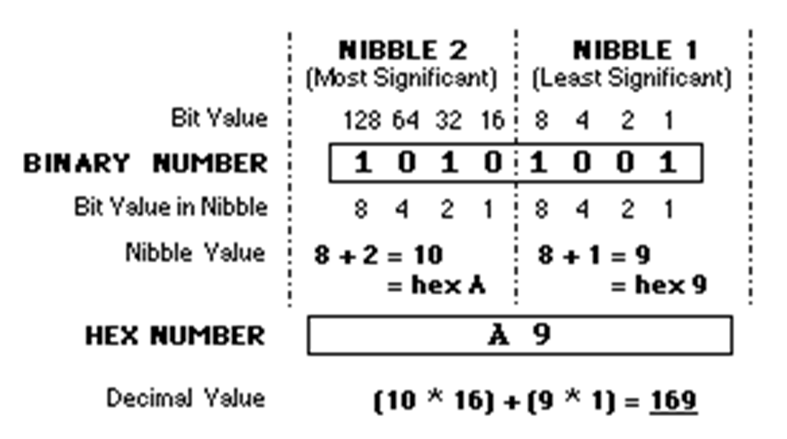
Hexadecimal
“Hex” is base 16
Why? easier than binary but related
8 bit byte holds 256 values. 16 * 16 = 256 thus Hex
0–15: One – Nine, Able, Baker, Charlie, Dog, Easy, Fox
Notes:
8 binary bits in a byte are split in half, and called a nibble. (yes, it's a joke, but really used. Two nibbles = one byte.)
How to “convert from Decimal to Binary to Hex”? Use Google. Or a programmer's calculator (built into Windoze+R calc)
256 is also 16^2, thus HEXADECIMAL – the Greek for six & Latin for 10. Less embarrassing than using the all Latin sexadecimal: "sex" for short would get awkward in the computer room.
IBM Mainframe programmers count in Hex using Able, Baker, Charlie, Dog, Easy, Fox not the international phonetic alphabet of Alpha, Bravo, Charlie, Delta, Echo, Foxtrot
Concept of nibbles: easier to count 0 to F twice than 0 to 255 all the time.
Core dumps and machine language are output in HEX.
In Canadian hexadecimal, why is 6 afraid of 7? Because 7 8 9 A? (Seven ate Nine, Eh?)

Slide 33
Hex
ASCII more accurately, US-ASCII American Standard Code for Information Interchange
0000 1010 \n is 0x0A or Oh-Able
0111 1111 (127)₁₀ is 0x7F or Seven-Fox
1111 1111 (255)₁₀ is 0xFF or Fox-Fox
HTML & URLs use HEX values for special characters
0010 0000 (32)₁₀ is 0x20 or %20 = space char
Notes:
https://en.wikipedia.org/wiki/ASCII
"traditional Chinese units of measurement were base-16"
https://en.wikipedia.org/wiki/Hexadecimal
https://en.wikipedia.org/wiki/Percent-encoding

Slide 34
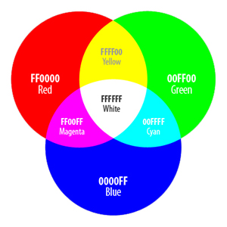
HTML uses Hexadecimal color codes
Hex codes of RGB triplets are used in HTML colour representations, as in: #XXXXXX
Red, Green, and Blue values range from 00 (lowest intensity) to FF (highest intensity) in HEX
FFFFFF is white (screen emits all colours) – presence of all visible wavelengths
00000 is black – absence of any visible wavelength
eLearning: Hex numbers
eLearning Tutorials Login needs your Seneca credentials and a LinkedIn account
Notes:
RGB = RED, GREEN, BLUE. Any of 16 million colours can be created from the combination of these Hex triplets
#FFFFFF is white – the presence of all visible wavelengths (screen emits all colours)
#00000 is black – the absence of any visible wavelength (screen emits nothing)
Back in the day, computers with 8-bit and 16-bit video cards could not display the wide range of colors allowed by the hex values, thus “web safe” colors were born.
https://en.wikipedia.org/wiki/Web_colors#Web-safe_colors

Slide 35
Notes
Not on the quiz but worth having an appreciation for…

Slide 36

Binary: Zero | One, On | Off, True | False
Leibniz (17th C) codifies the binary system
0 is the void, 1 is God.
Bit = Binary digit
unambiguous and unequivocal unit used to encode a message for transmission
(Claude Shannon, 1948. Bell Labs)
Byte = 8 bits − the smallest unit of data
256 possible values { 0 – 255 }
(W. Buchholz, 1956. )
Notes:
Leibniz, a great 17th C genius of the Enlightenment, wrote extensively of the binary number system. Many consider his work to be seminal to computer science. He articulated binary’s logical properties such as conjunction, disjunction, negation, identity, inclusion, and the empty set.
Claude Shannon needed a unit for transmitting information. “If the base 2 is used the resulting units may be called binary digits, or more briefly bits, a word suggested by J. W. Tukey.” [even a genius gives credit where credit is due]
SHANNON, C. E. (1948). A Mathematical Theory of Communication. The Bell System Technical Journal, 27, 379–423, 623–656. Retrieved from https://people.math.harvard.edu/~ctm/home/text/others/shannon/entropy/entropy.pdf
“was known for riding in the halls on a unicycle, sometimes juggling as well” See https://www.scientificamerican.com/article/claude-e-shannon-founder/
Bits are the elemental measure a computer uses: zero|one, on|off, yes|no, true|false. But how represent more than two values? E.g. letters, digits, symbols.
A byte is the smallest unit of data in computer architecture.
Werner Buchholz explains: “Byte denotes a group of bits used to encode a character…The term is coined from bite, but respelled to avoid accidental mutation to bit.” https://en.wikipedia.org/wiki/Byte#Etymology_and_history
Byte: A sequence of adjacent bits (binary digits) that can be operated on as a unit by a computer; the smallest usable machine word; nearly always eight bits, which can represent an integer from 0 to 255 or a single character of text. https://en.wikipedia.org/wiki/Word_(computer_architecture)
It is merely coincidental that there are eight bars in the IBM logo created in 1972 although, apocryphally, it is a good story that eight bars signifies eight bits.
The C and C++ programming languages define byte as an "addressable unit of data storage large enough to hold any member of the basic character set of the execution environment" (clause 3.6 of the C standard). The C standard requires that the integral data type char must hold at least 256 different values and is represented by at least eight bits (clause 5.2.4.2.1).
Binary Number Games
http://www.wordfreegames.com/game/binary-game.html (easy)
https://studio.code.org/projects/applab/iukLbcDnzqgoxuu810unLw (challenging)

Slide 37
Why Binary?
Unambiguous and Unequivocal state:
0 or 1 for storage of a value in a bit
Electric current in RAM, magnetic polarity on HDD, magic in SSD
Computer switches/storage reliably hold only two possible states
TRUE or FALSE to make a decision
hardware uses logic gates, software uses Boolean logic
All logic uses True | False → there is no maybe
Faster Processing:
CPUs, ALUs, FPUs, GPUs run better in binary
Notes:
CPUs, ALUs, FPUs, GPUs = central processing unit, arithmetic logic unit, floating-point unit, graphics processing unit
http://nookkin.com/articles/computer-science/why-computers-use-binary.ndoc
Why do all modern-day computers use binary then?
Simple answer: Computers weren't initially designed to use binary [early ALUs Arithmetic Logical Units were decimal]... rather, binary was determined to be the most practical system to use with the transistor/solid-state/semi-conductor computers that followed the invention of the microchip. In the 1960's binary ALUs were 15% faster than their decimal counterparts and were 15% less expensive. Companies only bought the platform then, there was no software to buy -- you made your own. Dealing with binary values instead of decimal was the programmers' problem.
Full answer: We only use binary because we currently do not have the technology to create "switches" that can reliably hold more than two possible states. (Quantum computers aren't exactly handy at the moment.) The binary system was chosen only because it is quite easy to distinguish the presence of an electric current from an absence of electric current (as is the case with semi-condictors, especially when working with trillions of such connections. That's all there is to it. Using any other number base in this type of system would require constant conversion, e.g. between binary and decimal or need sophisticated multiple-state switches adding orders of complexity to computer architecture.
https://github.com/freeCodeCamp/freeCodeCamp/issues/3074 –> see " SaintPeter commented on 26 Sep 2015" "transistors are little electrical switches. …are used in a computer … to represent a one or zero.
The cool thing is that, by the application of logic gates (AND/OR/XOR/etc) and Boolean Algebra https://en.wikipedia.org/wiki/Boolean_algebra, you can represent "Finite State Machines" (of which a general-purpose computer is a special case) which can, in turn make deterministic calculations."

Slide 38
Boolean Logic: Operator Truth Tables
If wishes were horses, beggars would ride.
Can you ride?
x — are wishes horses? y — have your own real horse?
x | NOT x
T | F
F | T
x | y | x AND y
T | T | T
T | F | F
F | T | F
F | F | F
x | y | x OR y
T | T | T
T | F | T
F | T | T
F | F | F
Notes:
When wishes really are horses ( x is true )
AND ( y is true ) you have your own horse; pick the wish horse or your own horse, and go riding. [If you are smart you’ll keep your wishes down to one horse. Horses eat money – you’re going to need another wish machine.]
AND ( y is false ) you don’t have a real horse, you cannot ride. [due to faulty wishing, you have a rocking horse]
OR ( y is true ) you have your own horse; pick the wish horse or your own horse, and go riding. OR ( y is false) ride the wish horse.
When wishes are not horses ( x is false, x is NOT true = !x in C),
AND ( y is true ) you have your own horse, you cannot go riding [because your horse needs the company of a wish horse]
AND ( y is false ) you have neither a wish horse nor your own horse, there is no horse to ride. OR ( y is true) you have and can ride your own horse [who is a stallion and quite comfortable on his own without a wish horse]
OR ( y is false ) there is neither a wish horse, nor your own horse – you are walking!

Slide 39
Safe, but slow, integer arithmetic
#include <limits.h>
int safe_add(int a, int b)
{
if (a >= 0) { // positive
if (b > (INT_MAX - a)) {
/* handle overflow */
}
} else { // negative
if (b < (INT_MIN - a)) {
/* handle overflow */
}
}
return a + b;
}
int safe_mult(int a, int b)
{ // efficiency: abs(a)>=abs(b) if (a == 0 || b == 0) { return 0; }
int x = a;
for (int i=2;i<=abs(b);i++) {
x = safe_add(a,x); }
if ( b < 0 ) { x = x * -1 }
return x;
}
Notes:
You cannot detect signed int overflow after the fact because signed int overflow is Undefined Behaviour. You must to write your code to avoid it or do a pre-test to trap overflow before it occurs.
How to detect integer overflow in C - Stack Overflow https://stackoverflow.com/questions/55468823/how-to-detect-integer-overflow-in-c
c - Catch and compute overflow during multiplication of two large integers - Stack Overflow https://stackoverflow.com/questions/1815367/catch-and-compute-overflow-during-multiplication-of-two-large-integers
Understanding Integer Overflow in C/C++ https://www.cs.utah.edu/~regehr/papers/overflow12.pdf

Slide 40
Bad Programming goes wrong
Ping of Death crashes small computers/servers in 1995/6
No validity checking on fragmented IP packets allows reassembly to exceed max. packet length (16-bit value) causing buffer overflow
Mars climate orbiter crashes in 1999
USC/Imperial versus Metric contest ended in a split decision
Antarctica's ozone layer hole discovered 7 years late
NASA software ignored values outside range of expected measurements. Tell-tale data was ignored from 1978 – 1985.
Lack of Random seeding could win you $1 million
Don't use rand() without first seeding with srand(NULL)
Notes:
1995/1996 – The Ping of Death. A lack of sanity checks and error handling in the IP fragmentation reassembly code makes it possible to crash a wide variety of operating systems by sending a malformed "ping" packet from anywhere on the internet. Affects primarily Windows machines but many Macintosh and Unix systems as well. Software that assumes a reassembled ping packet will conform to Internet Protocol documented in RFC 791 is subject to buffer overflow causing a system crash and potentially allowing the injection of malicious code.
https://en.wikipedia.org/wiki/Mars_Climate_Orbiter
One piece of ground software supplied by Lockheed Martin produced results in a United States Customary unit (~Imperial), contrary to its Software Interface Specification (SIS), while a second system, supplied by NASA, expected those results to be in SI (International System of metric) units. When the spacecraft arrived at Mars in 1999, the thrusters fired to put it into orbit around Mars. The "units of measure" discrepancy caused the spacecraft to pass through the upper atmosphere and disintegrate. The cost of the project was 327 million dollars and the 365 days it took the orbiter to reach Mars. Subsequently, time was spent investigating, pointing fingers, and blaming.
https://www.wired.com/2005/11/historys-worst-software-bugs/
http://royal.pingdom.com/2009/03/19/10-historical-software-bugs-with-extreme-consequences/
Antarctica's ozone layer hole discovered 7 years late
NASA's data analysis software had been programmed to flag and set aside data points that deviated greatly from expected measurements and so the initial measurements that should have set off alarms were simply overlooked. In short, the Total Ozone Mapping Spectrometer team failed to detect the ozone depletion seven years earlier because it was much more severe than scientists expected. "software contained quality-control code [known as a "reasonableness check"] to ignore ozone concentrations below 180 Dobson units as "probably bad" data. Concentrations that low had never been seen in Dobson network data, and could not be generated by any existing model. It was impossible as far as anyone knew, and it was a reasonable quality-control setting based on that knowledge. But the Antarctic ozone retrievals had come in well below the 180 unit setting. Their map of error flags for TOMS had showed the errors concentrated over the Antarctic in October. They had ignored it, however, assuming the instrument itself was faulty." (Conway, p.173, Atmospheric Science at NASA: A History)
➔ Now wait a minute, if the instrument was faulty, the error flags should be randomly distributed across all areas measured. Wasn't it odd that the instrument was faulty only when measuring Antarctic ozone?!? And if the instrument was faulty, then FIX IT! https://earthobservatory.nasa.gov/Features/RemoteSensingAtmosphere/remote_sensing5.php
➔ A case of "We see what we believe." In this case, we refuse to see what we don't believe. Instead of accepting all data and investigating anomalies, the process was to reject what they assumed would be spurious measurements. The absence of information IS information. Never just ignore data. Report the unexpected.
Checking Random seeding could win you $620,000
The Casino de Montreal opened in October of 1993. Among the many games was electronic KENO.
On Sunday, April 10, 1994, a freelance computer consultant by the name of Daniel Corriveau, playing electronic KENO at the Casino de Montreal, became the first known North American to beat a casino's electronic KENO game by successfully picking 19 out of 20 winning numbers. What is more, he did this three times in a row. The electronic KENO game and Monsieur Corriveau were promptly shut down. After a thorough police investigation, including a polygraph test, Mr. Corriveau was issued a cheque for $620,000 or ~$1M in today’s dollars. see http://catlin.casinocitytimes.com/article/non-random-randomness-part-1-1243
Obviously, the Keno machine programmer thought "The generation of random numbers was too important to be left to chance."
Most, if not all, computer languages contain a Random Number Generator (RNG). For programmer testing, one type of RNG initiates the random sequence with the same seed. Debugging and testing uses the same set of "random" numbers over and over again, differences and errors thereby being due to the program itself and not due to the random behavior of the RNG. Once the programmer is convinced that the program is sound, the RNG command is changed to use something close to a random seed, e.g. the computer's real time clock, giving a different set of numbers each time.
Corriveau knew about RNG behaviour. He slyly copied down the numbers the Keno machine was outputting over a period of many days and noticed a repeating pattern. This meant that the exact same sequence of KENO numbers were being "randomly" generated day after day. Corriveau made three bets at the appropriate times and won due to a) bad programming, b) naïve programming, c) poor software version control, or d) a bad clock in the Keno machine.

Slide 41

Numbering Systems
Humans tend to think…like humans.
Notes:
How many digits? I'm using the anatomical term because we are talking about numbers. …referring to fingers as digits in this context is funnier.
So, How many digits? it's ok, you don't need to answer. I can tell what you are thinking.
Nope, not ten. Ninety-nine. Really. Everybody: hands off your keyboard, both hands up. Make two fists to close your all digits. That's zero.

Slide 42
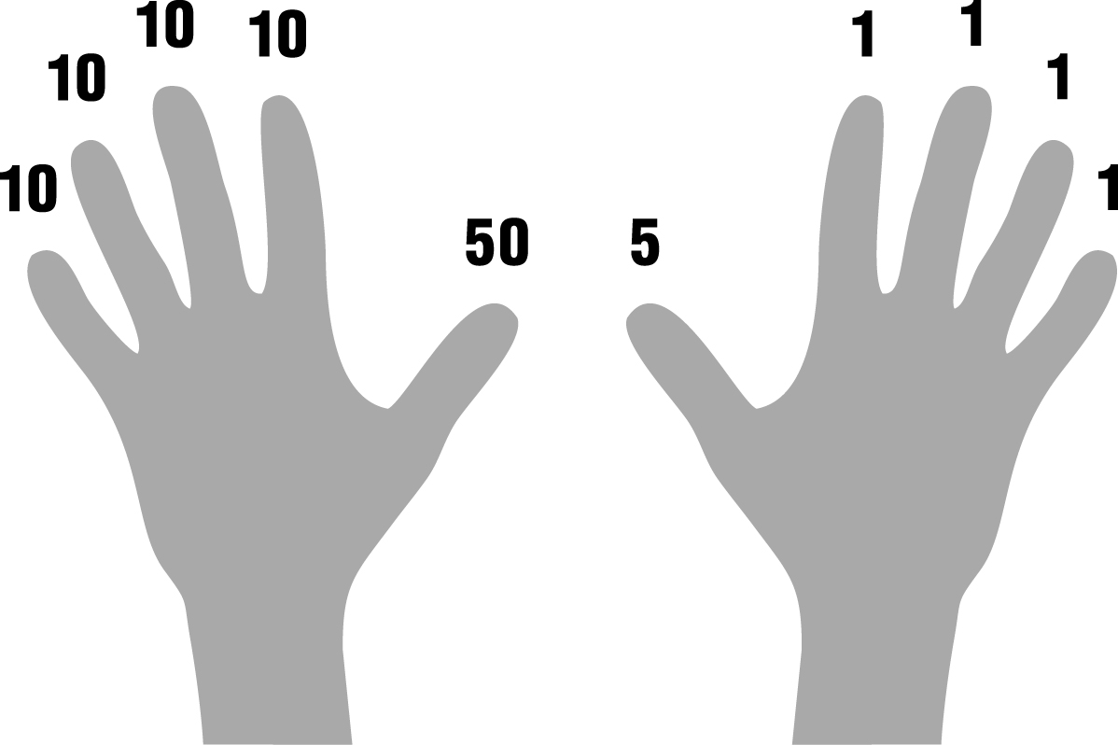
Numbering Systems
We can think differently.
Notes:
Count with me... one, two, three, four. (index to little finger) How's it going so far? You with me? I see everyone is keeping up. Now for the innovation, the big paradigm shift: FIVE with only the thumb up. The other four digits have had a rest and are coming back for six, seven, eight, nine...uh, oh. TEN. The other hand is the next order of magnitude. Twenty, thirty, ..., ninety -- nine!
It is possible to count from zero to 99 on ten fingers using a different number system. Just hold your hands up the screen if you forget.
This finger counting system may have been the origin of the Roman symbols: right hand fingers are ones and the thumb is five, left hand fingers are tens, and the thumb is fifty. This is a very useful method of counting and keeping track of numbers up to 99 in a noisy and busy environment. Fingers on the right hand go up, index to little for 1,2,3,4; then the fingers go down for 5 and the thumb comes up. Thumb + index to pinky for 6, 7, 8, 9. For 10, the right-hand closes and the left hand’s index finger goes up.

Slide 43
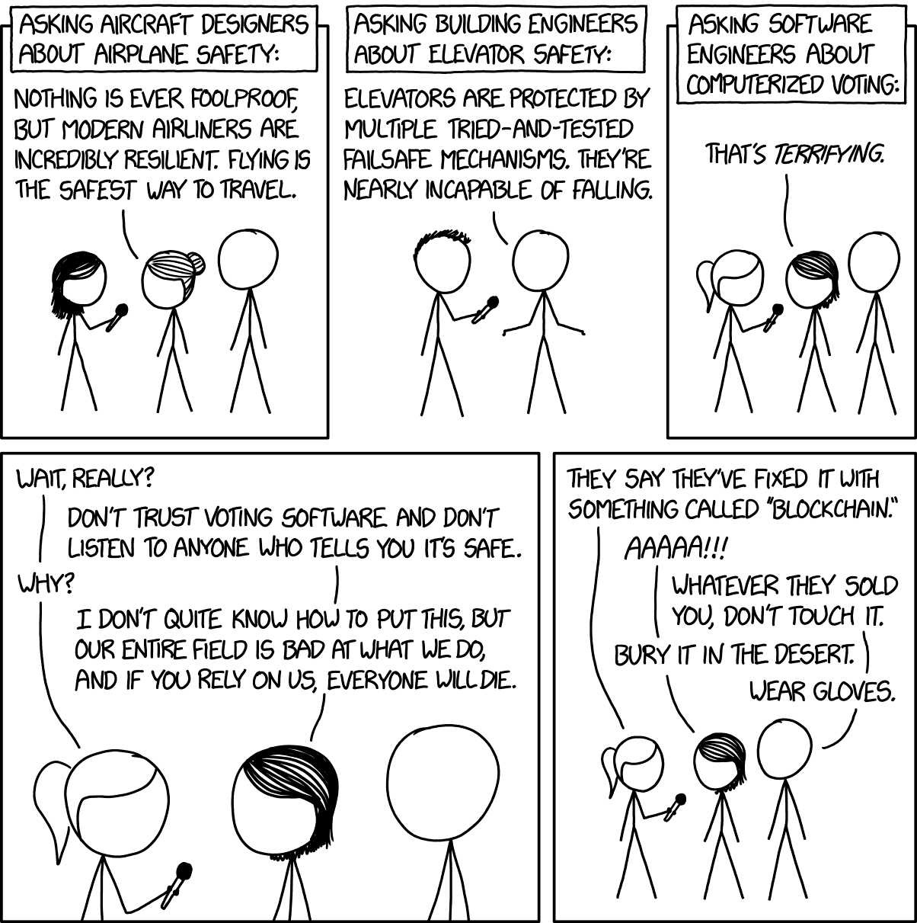
1 of 2
Notes:
https://xkcd.com/2030/
https://www.explainxkcd.com/wiki/index.php/2030:_Voting_Software
"People are scared of flying and elevators even though they are, statistically, very safe. However, the opposite is true for software engineers: When software engineers say something is dangerous, people don't believe them."
Continued on next slide

Slide 44
2 of 2
Notes:
There really are issues here and not only with online voting. (Local electronic vote counting systems are quite secure.) People have actually died.
The Therac-6 and Therac-20 medical radiation machines had mechanical safeties like airplanes and elevators. The Therac-25 didn't. More about that elsewhere in this slide deck.
Security experts have minimal concerns about blockchain hacking. Stealing Bitcoins has attracted thousands of hackers but they've only been successful stealing from e-Wallets. No one has embezzled Bitcoin's blockchain. The big problem is getting the vote from the voter's system (mobile app or web page) into the blockchain securely.
https://www.technologyreview.com/s/611850/why-security-experts-hate-that-blockchain-voting-will-be-used-in-the-midterm-elections/
https://www.technologyreview.com/s/610836/how-secure-is-blockchain-really/

Slide 45
Two's Complement
255 0
+127 01111111 max positive −128 10000000 min negative = −1 11111111 correct
+3 00000011 matching −3 11111101 pos and neg = 0 00000000 always zero
+127 01111111 max positive +1 00000001 add one −128 10000000 overflow
−128 10000000 min negative −1 11111111 sub one +127 01111111 overflow
----------------------unsigned----------------------
Notes:
How computers represent both positive and negative numbers. (Two's Complement is the most common method but it cannot be expected, there are other methods of internal representation which is determined by hardware design, not software.) Positive and Negative numbers share half the bits of an integer where zero is considered on the positive side. The most significant (leftmost) bit is off for positive and on for negative numbers.
The min/max for signed integers is ½ the maximum values for unsigned of the same type. Add any negative integer to a positive integer and the result will be correct in either binary or decimal arithmetic. Add any two negative and positive matching numbers and the result will always be zero. Meaning any value added or subtracted from zero will be correct.
The "complementary" aspect is that each positive binary number has a corresponding complement with equivalent but negative value. To compute the complement, invert all the bits and add 1.
+3 00000011
11111100 inversion
+1 conversion −3 11111101 complement
00000010 inversion
+1 conversion
+3 00000011 complement
1 is added due to the unequal distribution of non-zero positive and negative values within the integer.
Why share the bits this way, with half positive and half negative? Because, with two's-complement, the fundamental arithmetic operations of addition, subtraction, and multiplication are identical to those for both signed and unsigned binary numbers. This property makes the system both simpler to implement—there is no special handling of positive vs negative numbers—and is capable of easily handling higher precision arithmetic: just use more bits. (https://en.wikipedia.org/wiki/Two's_complement)
The disadvantage is overflow when 127 + 1 becomes −128. But we have that problem with unsigned binary numbers (255 + 1 = 0), with one's complement, and also with decimal numbers in programming or DB columns where there are always limits on maximum / minimum values.
Overflow goes to the bit bucket https://en.wikipedia.org/wiki/Bit_bucket
So you say your computer running slowly…hmmm, did you empty the bit bucket? No? Nobody told you? Well, that's the problem. Every time you end a program, the OS has to get rid of the used memory, so it throws the RAM your program used into the bit bucket. For efficiency, it leaves the zeros and only throws the 1 bits away. Your bit bucket has overflowed and is clogging things up. It's like taking out the garbage. Everyone throws stuff away but nobody likes cleaning up afterwards. "How do you empty the bit bucket?" Well, go to the back of the computer…okay, have you got a screwdriver? …
Reference https://www3.ntu.edu.sg/home/ehchua/programming/java/datarepresentation.html
This example shows a type __int8, a signed version of the char type which is rarely employed but useful for the example. Integers of larger size (more bits) have the same overflow behaviour.
"two's complement" is because it's in base 2. The general mathematical term is "radix complement" and radix for binary is 2.
https://en.m.wikipedia.org/wiki/Two's_complement
The two's complement is calculated by inverting the digits and adding one.
e.g.
Decimal +1 = binary 0000 0001 has this two's complement 1111 1111 which is -1 decimal
Decimal -1 = binary 1111 1111 has this two's complement 0000 0001 which is +1 decimal
Applies to values from -127 to 127. The negative is the complement of the positive and vice versa.
Two's complement of -128 is -128, of 0 is 0.
6 subtract 4 is handled as 6 + two's complement of 4 which is -4 6 + -4 = 2

Slide 46
Floats and Doubles — integer precision
float Single-precision floating-point (32-bit base-2)
Precision: 24 bits left & right of decimal, 6 decimals accuracy
Precision limit: +/- 16,777,216 exact integer values, 2²⁴
double Double-precision floating-point (64-bit base-2)
Precision: 53 bits left & right of decimal, 15 decimals accuracy
Precision limit: +/- 9,007,199,254,740,992 (9 quadrillion)
double calcs take longer to run but are safer than float
Actual properties of float and double are unspecified in C
Notes:
Why does this matter? See https://chromium.googlesource.com/chromium/src/+/50e671d0abbcaa3b4013a229c9759b33c77daf25 2018-01-24 M64: Ensure clamped time always moves forward This patch fixes a problem where performance.now or Date.now can in rare cases move slightly backwards due to a loss of arithmetic precision and rounding which is unavoidable when using floating point.
http://cottonvibes.blogspot.ca/2010/08/32bit-floats-integer-accuracy-and.html
Actual properties of float and double are unspecified (except that double is not smaller than float),
** therefore, portability between systems is not necessarily predictable **
however, on most systems, size and behaviour are according to IEEE 754 standards for floating-point format
where float is 32 bit and double is 64 bit. Floats and double exhibit identical behavior within the limits of a float.
When programming with floating point, know what you need: what range of values are processed and how exact must the results be.
Single-precision floating-point format (32-bit base-2 format)
The largest value representable by an n bit integer is 2^{n}-1. A float type has 24 bits of precision including
Powers of 2 within the range of the exponent are exactly representable as 1.0×2^{n}, so 2²⁴ can fit and consequently the first unrepresentable integer for float is 2²⁴+1. Declare a float and set it equal to 16,777,217. It is stored as 16,777,216. A float can store only even values > 16,777,216 rounded to nearest multiples of 2, 4, 8, ..., 128 depending on value.
Double precision floating point numbers can hold very, very large integer values exactly and fractional values are more accurate.
The largest value representable by an n bit integer is 2^{n}-1. A double type has 53 bits of precision in the significant digits (whole number to the left of decimal).
Powers of 2 within the range of the exponent are exactly representable as 1.0×2^{n}, so 2⁵³ can fit and consequently the first unrepresentable integer for double is 2⁵³+1. A double can store only even values > 9,007,199,254,740,992 (9 quadrillion) rounded to nearest multiples of 2, 4, 8, ..., 308 depending on value.
Execution speed with double-precision arithmetic
Using double-precision floating-point variables and mathematical functions (e.g., sin, cos, atan2, log, exp and sqrt) are slower than working with their single precision counterparts. One area of computing where this is a particular issue is for parallel code running on GPUs. For example, when using NVIDIA's CUDA platform, on video cards designed for gaming, calculations with double precision take 3 to 24 times longer to complete than calculations using single precision.^{[4]}

Slide 47
What is a Number System?
The “information stored and processed inside a computer system is represented in machine language which is only about 0s and 1s.”
Therefore, the memory contents (which are “all digits and numbers”) would be different from what we type (the strings of letters as an ex.) and we should have some ways to present them.
A Number System is a “writing system for expressing numbers;” It is a “mathematical notation for representing numbers of a given set,” using digits or other symbols in a consistent manner.
A Number System could also referred to as “a numeral system” or “system of numeration.” In this lecture, we will look at most common Number Systems.

Slide 48
Why do we need different number systems in computing? And Common Number Systems
A computer system “only understands numbers.” Therefore a computer “translates” all input including letters, words, special characters to numbers.
While we, as human beings, use our “Decimal” number system with 10 (0 - 9) digits, a computer understands “Binary” number system that has only 2 (0 and 1) digits. Different number systems are just “different views to same numbers, but in different systems.”
To represent binary numbers more concisely, we use “Hexadecimal” number system that uses 10 digits (0 – 9) and 6 symbols (A – F).
Each of these digits or symbols, represent different values “depending on their position in a given number.” – more on this soon.

Slide 49
Common Number Systems – Value of Digits in a Number
For each of the number systems mentioned, “the value of a digit in a number” is determined by:
“The digit itself.” (As an example in decimal, each of the digits 0 - 9 have different values)
“Position of the digit.” (As an example in decimal: 10s, 100s, 1000s, 10000s, etc.)
“The base of the number system.” (which is its total number of digits.) Decimal, binary, and hexadecimal use bases 10, 2, and 16 respectively.

Slide 50
Common Number Systems – Decimal Number System
Decimal Number System is the one which is “human preferred” and the one we use “in everyday life.”
“It has base 10 as it uses 10 digits (0 – 9).” The “values of digits increase from right to left:” 1s, 10s, 100s, 1000s, etc.
“Each successive position represents a specific power of base 10.” Take 1234 as an example. It has 4 in ones position, 3 in tens position, 2 in hundreds position, and 1 in thousands position and could be expressed as:
1234 = (1 x 10³) + (2 x 10²) + (3 x 10¹) + (4 x 10⁰)
= (1 x 1000) + (2 x 100) + (3 x 10) + (4 x 1)

Slide 51
Binary number system
Binary number system is “the one that a computer or machine understands.”
It uses only two digits: 0 and 1, which means “its base is 2” (or it’s a Base 2 number system.)
Like Decimal, “the values of digits increase from right to left” and “each successive position represents a specific power of base” (which is 2 in this case.)
Take (1001)2 as a binary number example. It could be expressed as:
(1001)2 = (1 x 2³) + (0 x 2²) + (0 x 2¹) + (1 x 2⁰)
= (1 x 8) + (0 x 4) + (0 x 2) + (1 x 1) = (9)10

Slide 52
Importance of Binary number system
“All data transfer, storage, and processing done by a microcomputer is performed digitally using binary” (base 2) codes.
This binary system “translates every character entered in the computer into a set of 1's and 0's.” As an example, computer represents the letter ‘A’ as 1000001 (or the code 65 in decimal.)
The advantage of binary coding over other methods is that “a sequence of only two possible states is required to represent a character in the electronic circuits of the computer.” Therefore, the smallest piece of information that needs to be stored in memory is a single binary digit.

Slide 53
Importance of Binary number system (Cont’d)
A single binary digit is called a “bit.” Different groupings of bits are used to represent different characters. A collection of eight bits is called a “byte.”
“One byte can represent any of 256 characters” (2⁸ =256). As an example, the word "bit" would require a total of three bytes of memory, one byte for each character in the word.
Since we are primarily concerned with how many characters the memory of a computer can hold, “memory size is referred to in units of bytes.”

Slide 54
Importance of Binary number system (Cont’d), and How to convert from Decimal to Binary and vice versa
In binary arithmetic, the power of 2 that is closest to 1000 is 2¹⁰ (2¹⁰ = 1024). Therefore, “in computer jargon, the prefix kilo stands for 1024.” Frequently, the word kilobyte is abbreviated “kB”. (Note the “k” is lower case because “K” in metric is reserved for the Kelvin temperature scale.)
a chip with 256kB of RAM can store 262,144 characters in memory (256 X 1024 = 262,144).
eLearning: binary and bits, binary numbers
eLearning Tutorials Login needs your Seneca credentials and a LinkedIn account since LinkedIn bought Lynda

Slide 55
Hexadecimal number system
Hexadecimal (or base 16 number system) uses “16 digits: 0 to 9, and A to F.” Letters A to F represent digits starting from 10 (A = 10, B = 11, C = 12, D = 13, E = 14, F = 15.)
Like other number systems, “the values of digits increase from right to left” and “each successive position represents a specific power of base” (which is 16 in this case.)
Take (19FD)₁₆ as a hexadecimal number example. It could be expressed as:
(19FD)16 = ((1 x 16³) + (9 x 16²) + (F x 16¹) + (D x 16⁰))
= (1 x 4096) + (9 x 256) + (15 x 16) + (13 x 1) = (6653)10

